Slide 1
Nonlinear Optics Study CH-1 Boyd, R. W. Nonlinear optics (4th ed.)
Kyungmin Kwon

Slide 2
1.1 Introduction to Nonlinear Optics

Slide 3
Introduction
Nonlinear Optics
The study of phenomena that occur as a consequence of the modification of the optical properties of a material system by the presence of light
Laser light is sufficiently intense to modify the optical properties of a material system
Meaning of “Nonlinear”
When the response of a material system to an applied optical field depends in a nonlinear manner on the strength of the applied optical system
In order to describe more precisely what we mean by an optical nonlinearity,
$$\tilde{P}\left(t\right)=ε_{0}χ^{(1)}\tilde{E}\left(t\right)$$
Polarization $\tilde{P}\left(t\right)$ (the dipole moment per unit volume of a material system)
$χ^{(1)}$ : linear susceptibility
$ε_{0}$ : permittivity of free space

Slide 4
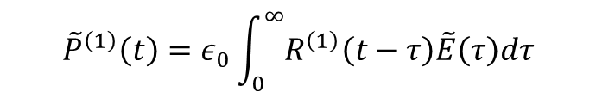
Optical Response for Nonlinear Optics
As a power series in the field strength $\tilde{E}\left(t\right)$
$$\tilde{P}\left(t\right)=ε_{0}\left[χ^{(1)}\tilde{E}\left(t\right)+χ^{(2)}{\tilde{E}}^{2}\left(t\right)+χ^{(3)}{\tilde{E}}^{3}\left(t\right)+… \right]$$
$$≡{\tilde{P}}^{\left(1\right)}\left(t\right)+{\tilde{P}}^{\left(2\right)}\left(t\right)+{\tilde{P}}^{\left(3\right)}\left(t\right)+…$$
$χ^{(1)},χ^{(2)}$ : second-rank tensor, third-rank tensor (the fields are vectors)
Dirac-delta function
$${\tilde{P}}^{\left(1\right)}\left(t\right)=ε_{0}\int_{0}^{∞}{R^{\left(1\right)}\left(t−τ\right)\tilde{E}\left(τ\right)dτ}$$
Assumption
The polarization at time $t$ depends only on the instantaneous value of the electric field strength
The medium must be lossless and dispersionless
Kramers-Kronig relations
In general, the nonlinear susceptibilities depend on the frequencies of the applied fields
Our assumption gives them to be constants

Slide 5
Optical Response for Nonlinear Optics
Polarization : Act as the source of new components of the electromagnetic field
$$∇^{2}\tilde{E}−\frac{n^{2}}{c^{2}}\frac{∂^{2}\tilde{E}}{∂t^{2}}=\frac{1}{ε_{0}c^{2}}\frac{∂^{2}{\tilde{P}}^{NL}}{∂t^{2}}$$
$n$ : linear refractive index
$c$ : the speed of light in vacuum
Inhomogeneous wave equation in which the polarization acts as a source term for the E-field
$$\frac{∂^{2}{\tilde{P}}^{NL}}{∂t^{2}}$$
A measure of the acceleration of the charges that constitute the medium
Consistent with Larmor’s theorem of Electromagnetism
(accelerated charges generate electromagnetic radiation)

Slide 6
1.2 Descriptions of Nonlinear Optical Processes

Slide 7
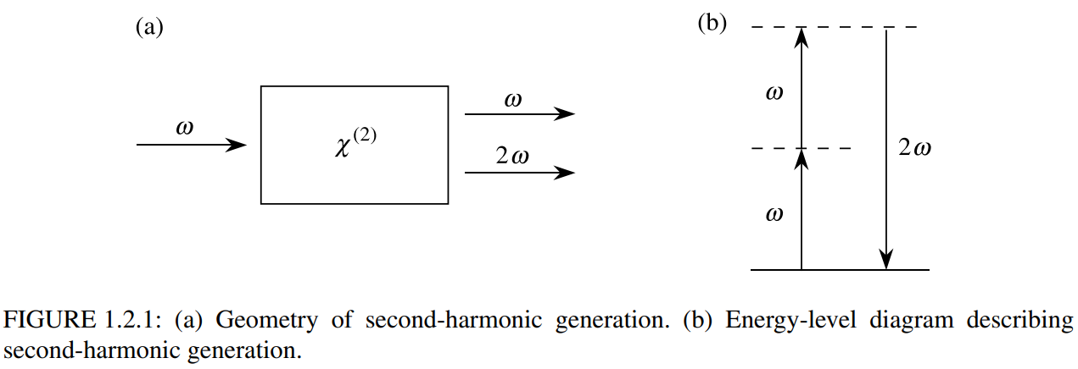
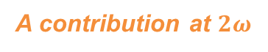
Second Harmonic Generation
Electric field strength of a laser beam in lossless medium
$$\tilde{E}\left(t\right)=Ee^{−iωt}+c.c.$$
It is incident upon a crystal for which the second-order susceptibility is nonzero
$${\tilde{P}}^{\left(2\right)}\left(t\right)=ε_{0}χ^{\left(2\right)}{\tilde{E}}^{2}\left(t\right)$$
$${\tilde{P}}^{\left(2\right)}\left(t\right)=2ε_{0}χ^{\left(2\right)}EE^{∗}+\left(ε_{0}χ^{\left(2\right)}e^{−2iωt}+c.c\right)$$
A contribution at zero frequency
A contribution at $2ω$
Driven Wave Equation
$$∇^{2}\tilde{E}−\frac{n^{2}}{c^{2}}\frac{∂^{2}\tilde{E}}{∂t^{2}}=\frac{1}{ε_{0}c^{2}}\frac{∂^{2}{\tilde{P}}^{NL}}{∂t^{2}}$$
Optical rectification : static electric field is created across the nonlinear crystal
The generation of radiation at $2ω$

Slide 8
Second Harmonic Generation (cont.)
Second-harmonic generation under experimental condition
Nearly all of the power in the incident beam at $ω$ is converted into radiation at the second-harmonic frequency $2ω$
One common use of SHG is to convert the output of a fixed-frequency laser to a different spectral region
Nd:YAG laser (infrared @ $λ=1.06 μm$) → to convert (middile of visible spectrum @ $λ=0.53 μm$)
Interaction in terms of the exchange of photons between the various frequencies of the field.
A single quantum-mechanical process
Two photon ($ω$) : destroyed, a photon ($2ω$) : simultaneously created
Solid line : the atomic ground state
Dashed line : virtual level
Not energy eigenlevels of the free atom
Combined energy of the atom and of one or more photons of radiation

Slide 9
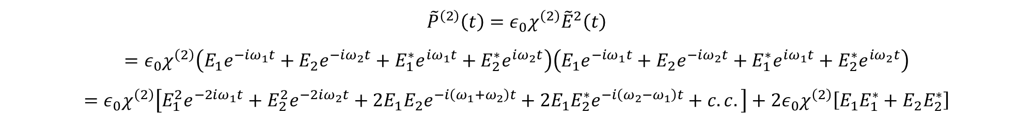
Sum and Difference-Frequency Generation
Optical field incident upon a second-order nonlinear optical medium
Two distinct frequency components
$$\tilde{E}\left(t\right)=E_{1}e^{−iω_{1}t}+E_{2}e^{−iω_{2}t}+E_{1}^{∗}e^{iω_{1}t}+E_{2}^{∗}e^{iω_{2}t}=E_{1}e^{−iω_{1}t}+E_{2}e^{−iω_{2}t}+c.c.$$
Nonlinear polarization
$${\tilde{P}}^{\left(2\right)}\left(t\right)=ε_{0}χ^{\left(2\right)}{\tilde{E}}^{2}\left(t\right)$$
$$=ε_{0}χ^{\left(2\right)}\left(E_{1}e^{−iω_{1}t}+E_{2}e^{−iω_{2}t}+E_{1}^{∗}e^{iω_{1}t}+E_{2}^{∗}e^{iω_{2}t}\right)\left(E_{1}e^{−iω_{1}t}+E_{2}e^{−iω_{2}t}+E_{1}^{∗}e^{iω_{1}t}+E_{2}^{∗}e^{iω_{2}t}\right)$$
$$=ε_{0}χ^{\left(2\right)}\left[E_{1}^{2}e^{−2iω_{1}t}+E_{2}^{2}e^{−2iω_{2}t}+2E_{1}E_{2}e^{−i\left(ω_{1}+ω_{2}\right)t}+2E_{1}E_{2}^{∗}e^{−i\left(ω_{2}−ω_{1}\right)t}+c.c.\right]+2ε_{0}χ^{\left(2\right)}\left[E_{1}E_{1}^{∗}+E_{2}E_{2}^{∗}\right]$$
The summation extends over positive and negative frequencies $ω_{n}$
$${\tilde{P}}^{\left(2\right)}\left(t\right)=\sum_{n}{P\left(ω_{n}\right)e^{−iω_{n}t}}$$

Slide 10
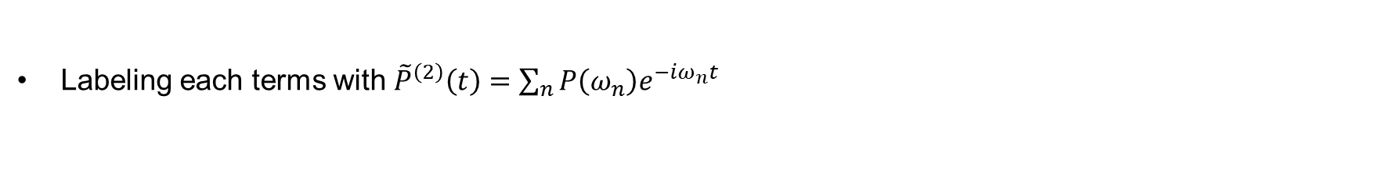

Sum and Difference-Frequency Generation (cont.)
The complex amplitudes of the various frequencies of the nonlinear polarizations
$${\tilde{P}}^{\left(2\right)}\left(t\right)=ε_{0}χ^{\left(2\right)}\left[E_{1}^{2}e^{−2iω_{1}t}+E_{2}^{2}e^{−2iω_{2}t}+2E_{1}E_{2}e^{−i\left(ω_{1}+ω_{2}\right)t}+2E_{1}E_{2}^{∗}e^{−i\left(ω_{2}−ω_{1}\right)t}+c.c.\right]+2ε_{0}χ^{\left(2\right)}\left[E_{1}E_{1}^{∗}+E_{2}E_{2}^{∗}\right]$$
Labeling each terms with ${\tilde{P}}^{\left(2\right)}\left(t\right)=\sum_{n}{P\left(ω_{n}\right)e^{−iω_{n}t}}$
$$P\left(2ω_{1}\right)=ε_{0}χ^{\left(2\right)}E_{1}^{2}, P\left(2ω_{2}\right)=ε_{0}χ^{\left(2\right)}E_{2}^{2}$$
$$P\left(ω_{1}+ω_{2}\right)=2ε_{0}χ^{\left(2\right)}E_{1}E_{2}, P\left(ω_{1}−ω_{2}\right)=2ε_{0}χ^{\left(2\right)}E_{1}E_{2}^{∗}$$
$$P\left(0\right)=2ε_{0}χ^{\left(2\right)}\left[E_{1}E_{1}^{∗}+E_{2}E_{2}^{∗}\right]$$
SHG
SHG
SFG
DFG
OR
Response at the negative frequency components
$$P\left(−2ω_{1}\right)=ε_{0}χ^{\left(2\right)}{E_{1}^{∗}}^{2}, P\left(−2ω_{2}\right)=ε_{0}χ^{\left(2\right)}{E_{2}^{∗}}^{2}$$
$$P\left({−ω}_{1}−ω_{2}\right)=2ε_{0}χ^{\left(2\right)}E_{1}^{∗}E_{2}^{∗}, P\left(ω_{2}−ω_{1}\right)=2ε_{0}χ^{\left(2\right)}E_{2}E_{1}^{∗}$$
SHG
SHG
SFG
DFG

Slide 11

Phase-matching
Introduction to phase-matching condition
Four different nonzero frequency components
$$P\left(2ω_{1}\right)=ε_{0}χ^{\left(2\right)}E_{1}^{2}, P\left(2ω_{2}\right)=ε_{0}χ^{\left(2\right)}E_{2}^{2}$$
$$P\left(ω_{1}+ω_{2}\right)=2ε_{0}χ^{\left(2\right)}E_{1}E_{2}, P\left(ω_{1}−ω_{2}\right)=2ε_{0}χ^{\left(2\right)}E_{1}E_{2}^{∗}$$
$$P\left(0\right)=2ε_{0}χ^{\left(2\right)}\left[E_{1}E_{1}^{∗}+E_{2}E_{2}^{∗}\right]$$
SHG
SHG
SFG
DFG
OR
Typically, no more than one of four frequency components are present in the nonlinear polarization
The nonlinear polarization can efficiently produce an output signal only if a certain phase-matching condition is satisfied
Usually this condition cannot be satisfied for more than one frequency component of the nonlinear polarization
Radiated frequencies are selected via input polarization and crystal orientation

Slide 12
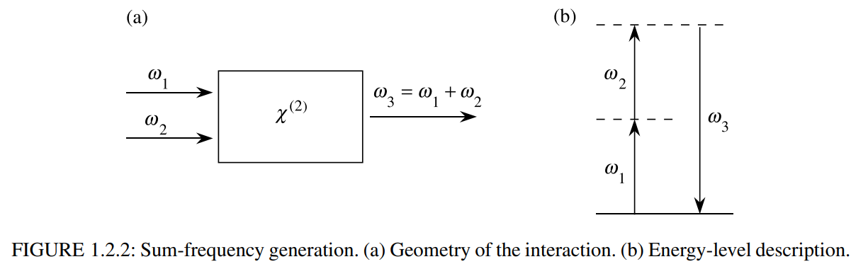
Sum-Frequency Generation
The process of SFG
$$P\left(2ω_{1}\right)=ε_{0}χ^{\left(2\right)}E_{1}^{2}$$
SFG is analogous to that of SHG, except that in SFG the two input waves are at different frequencies
Application of SFG
To produce : tunable radiation @ ultraviolet region
Choosing the input waves : fixed frequency laser and frequency-tunable laser @ visible region

Slide 13
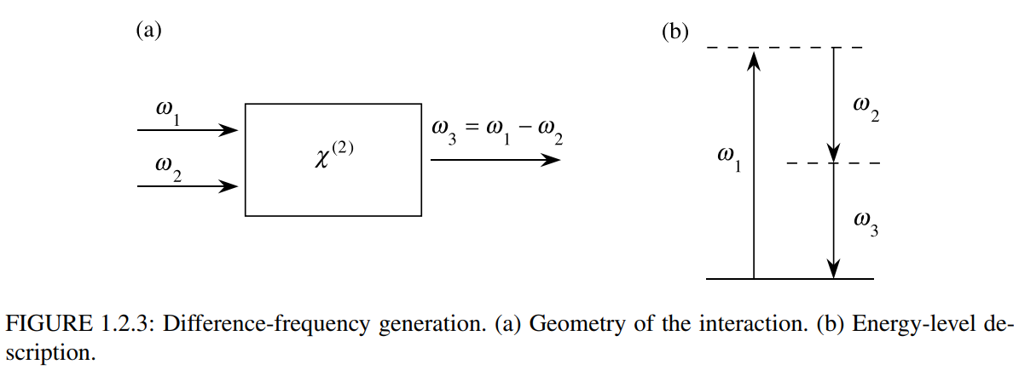
Difference-Frequency Generation
The process of DFG
$$P\left({ω_{2}−ω}_{1}\right)=2ε_{0}χ^{\left(2\right)}E_{1}E_{2}^{∗}$$
Application of DFG
To produce : tunable radiation @ infrared region
By choosing the input waves : fixed frequency laser and frequency-tunable laser @ visible region
DFG and SFG appear to be very similar processes

Slide 14
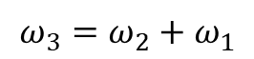
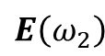
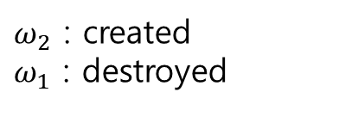

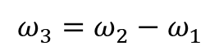
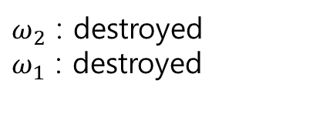
Optical parametric amplification
Difference between SFG and DFG
Conservation of energy
$${ω_{3}=ω_{2}+ω}_{1}$$
$${ω_{3}=ω_{2}−ω}_{1}$$
$ω_{2}$ : destroyed
$ω_{1}$ : destroyed
$ω_{2}$ : created
$ω_{1}$ : destroyed
$$E\left(ω_{2}\right)$$
DFG
Photon ($ω_{3}$) : A photon ($ω_{1}$) is destroyed and a photon ($ω_{2}$) is created
The atom first absorbs a photon of frequency $ω_{1}$ and jumps to the highest virtual level
This level decays by a two-photon emission process that is stimulated by the $ω_{2}$ field
The lower-frequency input field is amplified by the process of DFG
Optical parametric amplification
If the absence of the $ω_{2}$ field?

Slide 15
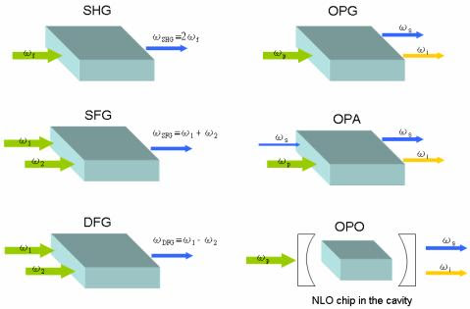
Optical parametric amplification

Slide 16
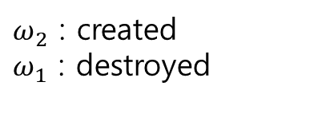
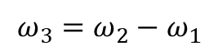
Spontaneous Parametric Down Conversion
The absence of E-field
Even if the $ω_{2}$ field is not applied, two-photon emission can occur.
$${ω_{3}=ω_{2}−ω}_{1}$$
$ω_{2}$ : created
$ω_{1}$ : destroyed
In such a case, the generated fields are very much weaker
They are created by spontaneous two-photon emission from a virtual level
Spontaneous parametric down-conversion or Parametric fluorescence

Slide 17
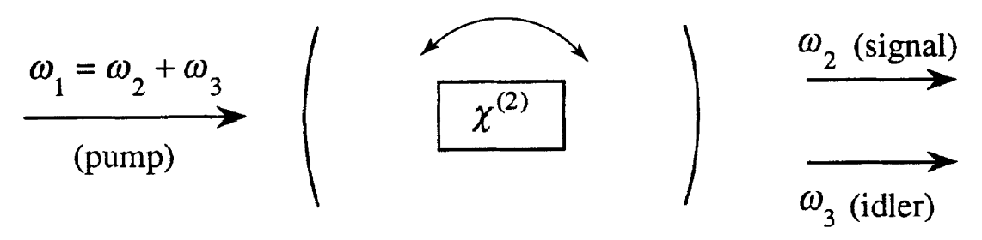
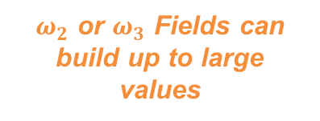
Optical Parametric Oscillation
In the process of DFG that the presence of radiation at $ω_{2}$ or $ω_{3}$ can stimulate the emission of photon
If the nonlinear crystal used in this process is placed inside an optical resonator,
$ω_{2}$ or $ω_{3}$ Fields can build up to large values
Optical Parametric Oscillator
A device is broadly tunable because of their extremely broad tuning range
$${ω_{1}=ω_{2}+ω}_{3}, ω_{2}<ω_{1}$$
In practical,
Controlling output frequency of an optical parametric oscillator by adjusting phase-matching condition
The applied field frequency $ω_{1}$ : pump frequency
The desired output frequency : signal frequency ; The unwanted output frequency : idler frequency

Slide 18
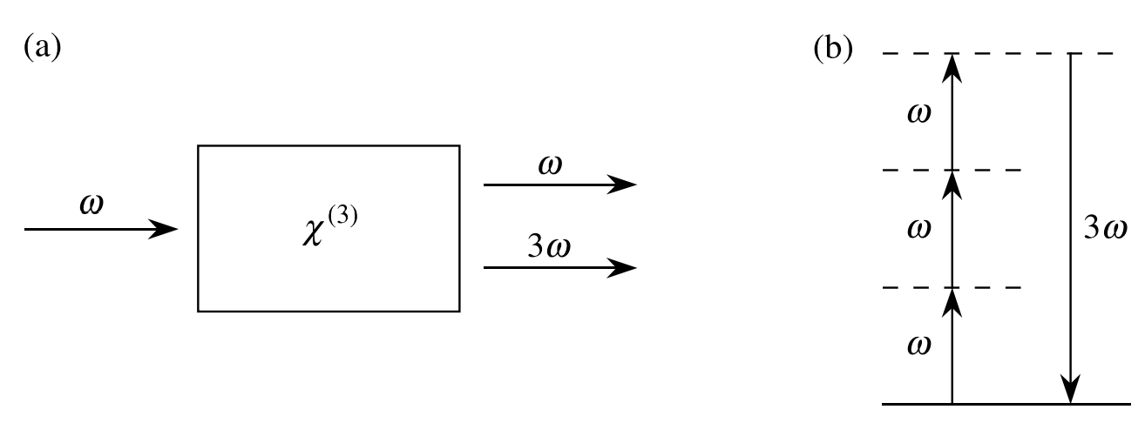
Third-Order Nonlinear Optical Processes
Third order contribution to the nonlinear polarization
$${\tilde{P}}^{(3)}\left(t\right)=ε_{0}χ^{(3)}\tilde{E}{\left(t\right)}^{3}$$
Generally, the E-field is made up of several different frequency components
But it is very complicated, so we first consider monochromatic applied field
$$\tilde{E}\left(t\right)=ℰ\cos\left(ωt\right)$$
$${\tilde{P}}^{(3)}\left(t\right)=\frac{1}{4}ε_{0}χ^{(3)}ℰ^{3}\cos^{3}\left(3ωt\right)+\frac{3}{4}ε_{0}χ^{(3)}ℰ^{3}\cos\left(ωt\right)$$
Third-harmonic generation
Three photons $(ω)$ are destroyed
One photon $(3ω)$ is created

Slide 19

Intensity-Dependent Refractive Index
Nonlinear contribution to the refractive index
$${\tilde{P}}^{(3)}\left(t\right)=\frac{1}{4}ε_{0}χ^{(3)}ℰ^{3}\cos^{3}\left(3ωt\right)+\frac{3}{4}ε_{0}χ^{(3)}𝓔^{3}\cos\left(ωt\right)$$
The refractive index in the presence of this type of nonlinearity
$$n=n_{0}+n_{2}I$$
$$n_{2}=\frac{3}{4n_{0}^{2}ε_{0}c}χ^{(3)}$$
Optical constant in lossless medium
$n_{0}$ : usual (linear or low-intensity) refractive index
$n_{0}$ $I=\frac{1}{2}n_{0}ε_{0}cℰ^{2}$ : the intensity of incident wave

Slide 20
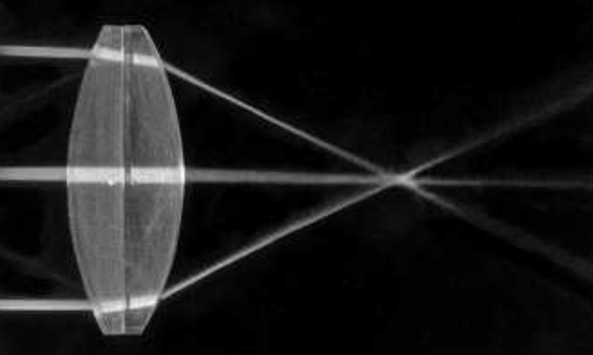
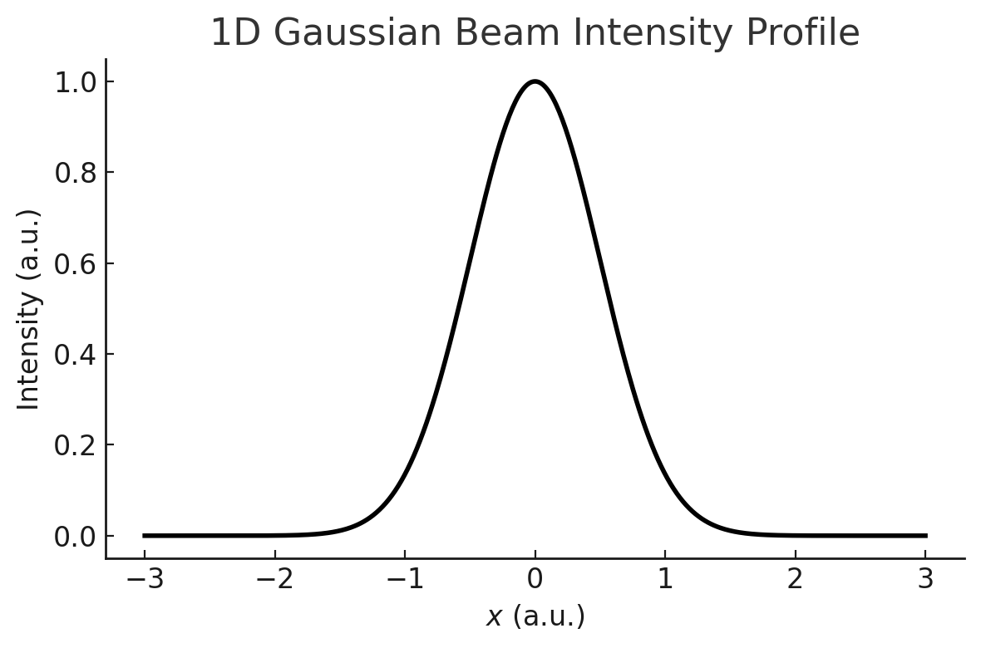
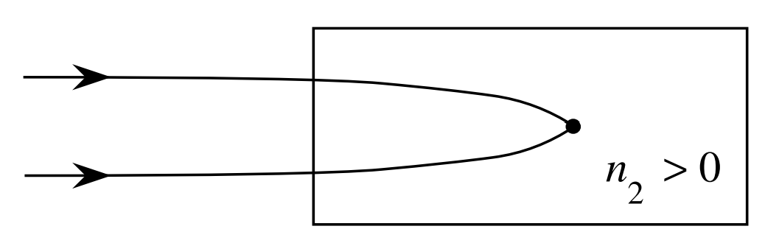
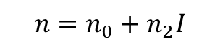
Self Focusing
If intensity-dependent refractive index is Self-Focusing
$$n=n_{0}+n_{2}I$$
the material effectively acts as a positive lens
The process can occur when a beam of light having a nonuniform transverse intensity distribution propagates through a material for which $n_{2}$ is positive
The intensity at the focal spot of the self focused beam is usually sufficiently large to lead to optical damage of the material

Slide 21
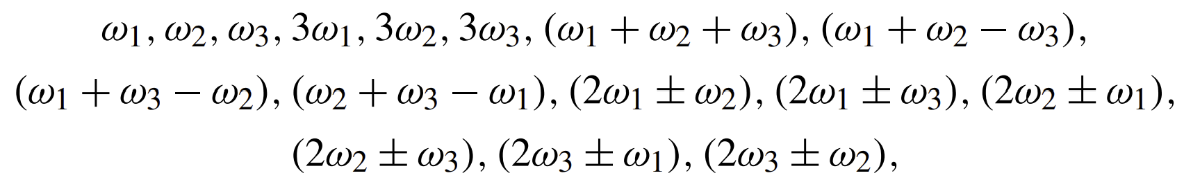
Third-Order Interactions (General Case)
Nonlinear polarization consists of three frequency components
$${\tilde{P}}^{(3)}\left(t\right)=ε_{0}χ^{(3)}\tilde{E}{\left(t\right)}^{3}$$
$$\tilde{E}\left(t\right)=E_{1}e^{−iω_{1}t}+E_{2}e^{−iω_{2}t}+E_{3}e^{−iω_{3}t}++c.c.$$
When calculating $\tilde{E}{\left(t\right)}^{3}$, we find 44 different frequency components (considering positive and negative frequencies)

Slide 22
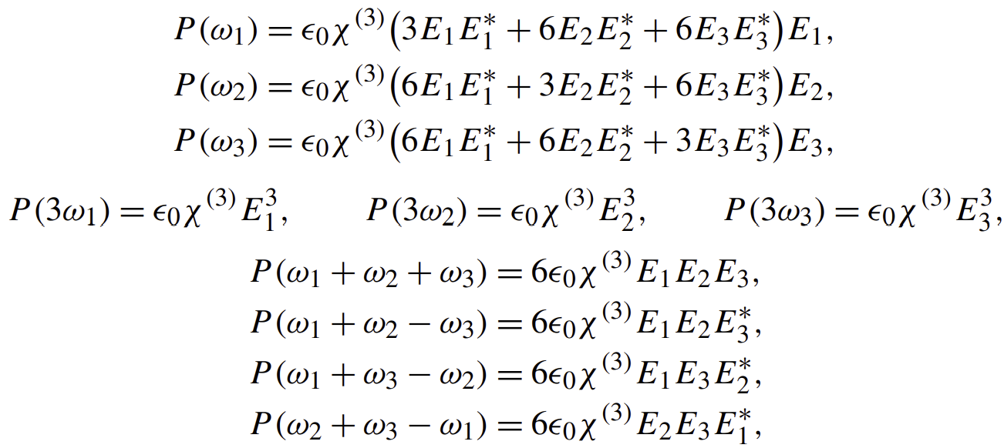
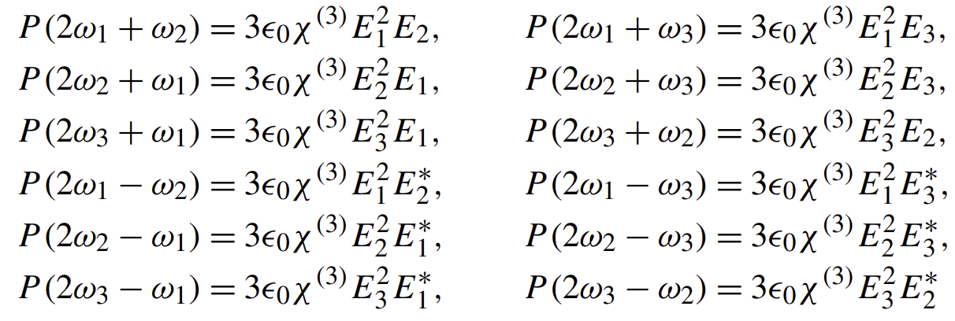
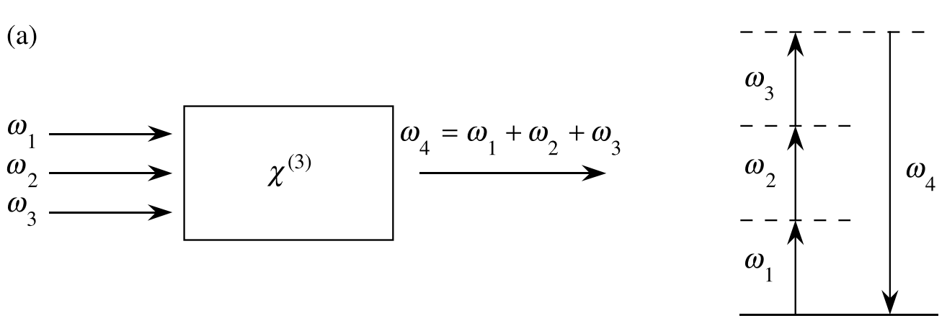
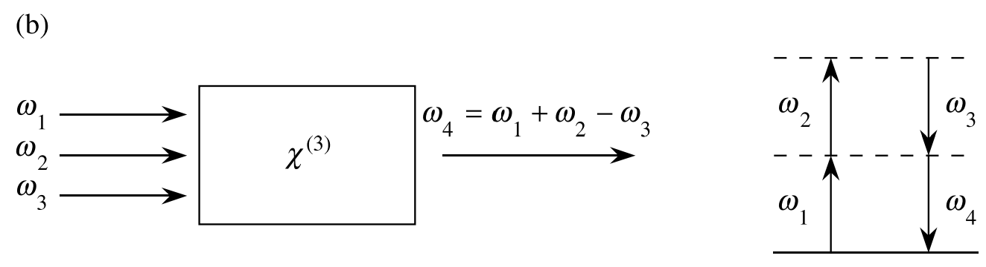
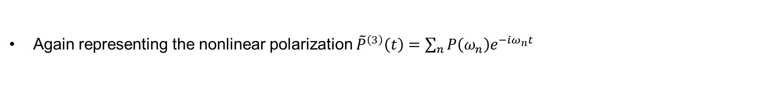
Third-Order Interactions (General Case)
Again representing the nonlinear polarization ${\tilde{P}}^{\left(3\right)}\left(t\right)=\sum_{n}{P\left(ω_{n}\right)e^{−iω_{n}t}}$
Distinct permutation

Slide 23
Parametric versus Nonparametric Processes
Parametric
Parametric : a process in which the initial and final quantum-mechanical states of the system are identical
In a parametric process, population can be removed from the ground state only for those brief intervals of time when it resides in a virtual level
By uncertainty principle, population can reside in a virtual level for a time interval
$$\sim ℏ/δE$$
$δE$ : energy difference between the virtual level and the nearest real level
Nonparametric
Processes that do involve the transfer of population from one real level to another

Slide 24
Parametric versus Nonparametric Processes
Parametric vs Nonparametric
Parametric : always be described by a real susceptibility
Nonparametric : described by a complex susceptibility
Parametric : Photon energy is always conserved.
Nonparametric : Photon energy need not be conserved
Because energy can be transferred to or from the material medium
Example of parametric vs nonparametric
Parametric : real part of the refractive index
Nonparametric : imaginary part of the refractive index describes the absorption of radiation
It results from the transfer of population from the atomic ground state to an excited state
$$E\left(r\right)\sim e^{ikr}=e^{i\left(\frac{n_{R}}{c}\right)ωr}e^{i(i)\left(\frac{n_{I}}{c}\right)ωr}=E_{R}e^{−\left(\frac{n_{I}}{c}\right)ωr}$$

Slide 25
Saturable Absorption
Saturable Absorption
Many material systems : absorption coefficient decreases when the laser intensity is high
$$α=\frac{α_{0}}{1+I/I_{s}}$$
$α_{0}$ : low-intensity absorption coefficient
$I_{s}$ : saturation intensity
Absorption Coefficient
$$α=−\left(\frac{1}{I}\right)\left(\frac{dI}{dz}\right), I\left(z\right)=I\left(0\right)\exp\left(−αz\right)$$

Slide 26
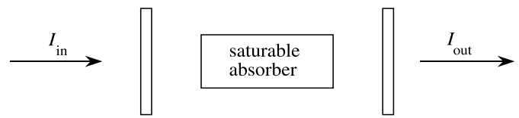
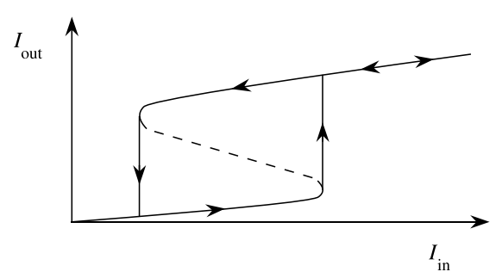

Saturable Absorption
Optical Bistability
Bistable optical device : a saturable absorber inside a Fabry-Perot resonator
$$α=\frac{α_{0}}{1+I/I_{s}}$$
Input intensity ↑ → field in the cavity ↑ → absorption ↓ → field intensity ↑
Subsequently, if input intensity is lowered, the field intensity tends to remain large
Absorption of the material system has already been reduced (saturated)
Over some range of input intensities more than one output intensity is possible

Slide 27
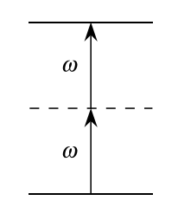
Two Photon Absorption
Two photon absorption
An atom makes a transition from its ground state to an excited state by the simultaneous absorption of two laser photons
Absorption cross section $σ$ : the total area of incident beam is scattered by the target
$$σ=σ^{(2)}I$$
$σ^{(2)}$ : coefficient that describes strength of the two-photon-absorption process
In linear optics, $σ$ is a constant
Atomic transition rate $R$
$$R=\frac{σI}{ℏω}=\frac{σ^{(2)}I^{2}}{ℏω}$$
Application : spectroscopic tool for determining the positions of energy levels that are not connected to the atomic ground state by a one-photon transition

Slide 28
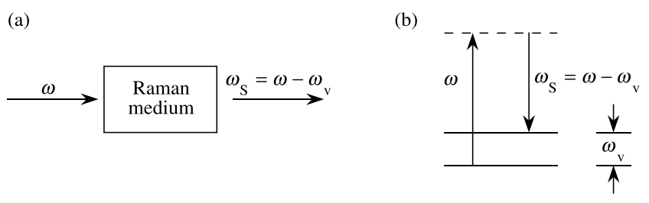
Stimulated Raman Scattering
Stimulated Raman Scattering
A photon ($ω$) is annihilated and a photon at the Stokes-shifted frequency $ω_{s}=ω−ω_{v}$ is created
Leaving the molecule (or atom) in an excited state with energy $ℏω_{v}$
Vibrational energy
The efficiency of stimulated Raman scattering can be quite large $\sim 10\%$ or more of the power
The efficiency of normal or spontaneous Raman scattering is many orders of magnitude lower
Other stimulated scattering processes also occur. (Brillouin, Rayleigh scattering)

Slide 29
1.3 Formal Definition of the Nonlinear Susceptibility

Slide 30
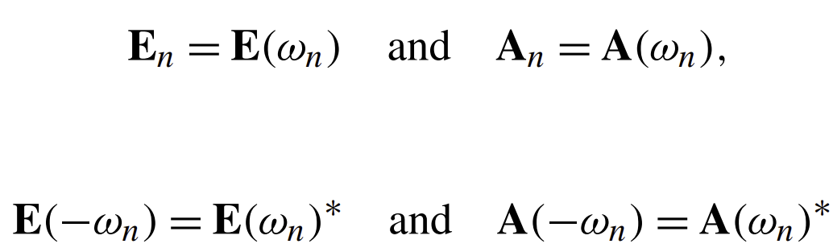
E-field of the Frequency Components
General case of a material with dispersion and/or absorption
Nonlinear susceptibility : a complex quantity
Assuming the E-field vector as the discrete sum of a number of frequency components
$$\tilde{E}\left(r,t\right)=\sum_{n}{{\tilde{E}}_{n}\left(r,t\right)}$$
$$′$$
Summation over positive frequency
$${\tilde{E}}_{n}\left(r,t\right)=E_{n}\left(r\right)e^{−iω_{n}t}+c.c.$$
Assuming that to define the spatially slowly varying field amplitude $A_{n}$
$$E_{n}\left(r\right)=A_{n}e^{ik_{n}∙r}$$
$$\tilde{E}\left(r,t\right)=\sum_{n}{A_{n}e^{i\left(k_{n}∙r−ω_{n}t\right)}+c.c.}$$
$$′$$
Rewrite the total field
$$\tilde{E}\left(r,t\right)=\sum_{n}{E\left(ω_{n}\right)e^{−iω_{n}t}}=\sum_{n}{A\left(ω_{n}\right)e^{i\left(k_{n}∙r−ω_{n}t\right)}}$$

Slide 31
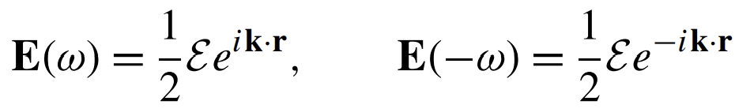
E-field of the Frequency Components (cont.)
General case of a material with dispersion and/or absorption
Definition of field amplitude
$$\tilde{E}\left(r,t\right)=\sum_{n}{E\left(ω_{n}\right)e^{−iω_{n}t}}=\left[E\left(ω_{1}\right)e^{−iω_{1}t}+E\left({−ω}_{1}\right)e^{iω_{1}t}\right]+\left(\left[E\left(ω_{2}\right)e^{−iω_{2}t}+E\left({−ω}_{2}\right)e^{iω_{2}t}\right]\right)+…$$
$$\tilde{E}\left(r,t\right)=ℰ\cos\left(k∙r−ωt\right)$$
Or alternatively, by the slowly varying amplitude
$$A\left(ω\right)=\frac{1}{2}𝓔, A\left(−ω\right)=\frac{1}{2}ℰ$$
$$′$$
The nonlinear polarization
$$\tilde{P}\left(r,t\right)=\sum_{n}{P\left(ω_{n}\right)e^{−iω_{n}t}}$$

Slide 32
Second-order Nonlinear Polarization
Define the components of the second-order susceptibility tensor (constant)
$$χ_{ijk}^{\left(2\right)}\left(ω_{n}+ω_{m},ω_{n},ω_{m}\right)$$
Nonlinear polarization is proportional to second-order susceptibility tensor
$$P_{i}\left(ω_{n}+ω_{m}\right)=ε_{0}\sum_{jk}{\sum_{\left(nm\right)}{χ_{ijk}^{\left(2\right)}\left(ω_{n}+ω_{m},ω_{n},ω_{m}\right)E_{j}\left(ω_{n}\right)E_{k}\left(ω_{m}\right)}}$$
$ijk$ : Cartesian components of the fields
$\left(nm\right)$: Summation over $n, m$
$E_{j}\left(ω_{n}\right)E_{k}\left(ω_{m}\right)\sim e^{−i\left(ω_{n}+ω_{m}\right)t}$ : Nonlinear polarization oscillates at $\left(ω_{n}+ω_{m}\right)$
$$′$$
$χ_{ijk}^{\left(2\right)}\left(ω_{n}+ω_{m},ω_{n},ω_{m}\right)$: sometimes written as $χ_{ijk}^{\left(2\right)}\left(ω_{n}+ω_{m};ω_{n},ω_{m}\right)$ because $ω_{3}=ω_{1}+ω_{3}$
Let’s examine two simple examples

Slide 33
Sum Frequency Generation
SFG : $ω_{3}=ω_{1}+ω_{2}$
$$P_{i}\left(ω_{3}\right)=ε_{0}\sum_{jk}{\left[χ_{ijk}^{\left(2\right)}\left(ω_{3};ω_{1},ω_{2}\right)E_{j}\left(ω_{1}\right)E_{k}\left(ω_{2}\right)+χ_{ijk}^{\left(2\right)}\left(ω_{3};ω_{2},ω_{1}\right)E_{j}\left(ω_{2}\right)E_{k}\left(ω_{1}\right)\right]}$$
$j,k$ : dummy indices, they can be interchanged
$$χ_{ikj}^{\left(2\right)}\left(ω_{3};ω_{1},ω_{2}\right)E_{j}\left(ω_{1}\right)E_{k}\left(ω_{2}\right)$$
Assuming that the nonlinear susceptibility possesses intrinsic permutation symmetry
$$χ_{ijk}^{\left(2\right)}\left(ω_{3};ω_{1},ω_{2}\right)=χ_{ikj}^{\left(2\right)}\left(ω_{3};ω_{2},ω_{1}\right)$$
$$P_{i}\left(ω_{3}\right)=2ε_{0}\sum_{jk}{χ_{ijk}^{\left(2\right)}\left(ω_{3};ω_{1},ω_{2}\right)E_{j}\left(ω_{1}\right)E_{k}\left(ω_{2}\right)}$$
For the special case, both input fields are polarized in the $x$ direction
$$P_{i}\left(ω_{3}\right)=2ε_{0}χ_{ixx}^{\left(2\right)}\left(ω_{3};ω_{1},ω_{2}\right)E_{x}\left(ω_{1}\right)E_{x}\left(ω_{2}\right)$$

Slide 34
Sum Harmonic Generation
SHG : input frequency as $ω_{3}$, $ω_{3}=2ω_{1}$
$$P_{i}\left(ω_{3}\right)=ε_{0}\sum_{jk}{χ_{ijk}^{\left(2\right)}\left(ω_{3};ω_{1},ω_{1}\right)E_{j}\left(ω_{1}\right)E_{k}\left(ω_{1}\right)}$$
SHG
Assuming both input fields are polarized in the $x$ direction
$$P_{i}\left(ω_{3}\right)=ε_{0}χ_{ixx}^{\left(2\right)}\left(ω_{3};ω_{1},ω_{1}\right)E_{x}{\left(ω_{1}\right)}^{2}$$
About a factor of 2
$$P_{i}\left(ω_{3}\right)=2ε_{0}\sum_{jk}{χ_{ijk}^{\left(2\right)}\left(ω_{3};ω_{1},ω_{2}\right)E_{j}\left(ω_{1}\right)E_{k}\left(ω_{2}\right)}$$
SFG
As $ω_{2}$ goes $ω_{1}$, $χ_{ijk}^{\left(2\right)}\left(ω_{3};ω_{1},ω_{1}\right)$ must approach $χ_{ijk}^{\left(2\right)}\left(ω_{3};ω_{1},ω_{2}\right)$ in SFG
Why doesn’t the factor of 2 appear at first in the SHG expression? Because our susceptibility convention lists each input frequency in an ordered permutation
Someone thought : “polarization produced by two distinct fields is larger than that produced by single field”
NO
Define the degeneracy factor $D$ that is equal to the number of distinct permutations of the applied field

Slide 35
Degeneracy Factor and Third-order Susceptibility
Considering with degeneracy factor D
$$P_{i}\left(ω_{n}+ω_{m}\right)=ε_{0}D\sum_{jk}{χ_{ijk}^{\left(2\right)}\left(ω_{n}+ω_{m},ω_{n},ω_{m}\right)E_{j}\left(ω_{n}\right)E_{k}\left(ω_{m}\right)}$$
Third-order susceptibility
$$P_{i}\left(ω_{o}+ω_{n}+ω_{m}\right)=ε_{0}\sum_{jk}{χ_{ijkl}^{\left(3\right)}\left(ω_{o}+ω_{n}+ω_{m},ω_{o},ω_{n},ω_{m}\right)E_{j}\left(ω_{o}\right)E_{k}\left(ω_{n}\right)E_{l}\left(ω_{m}\right)}$$
Considering with degeneracy factor that represents the number of distinct permutations of the frequencies
$$P_{i}\left(ω_{o}+ω_{n}+ω_{m}\right)=ε_{0}D\sum_{jk}{χ_{ijkl}^{\left(3\right)}\left(ω_{o}+ω_{n}+ω_{m},ω_{o},ω_{n},ω_{m}\right)E_{j}\left(ω_{o}\right)E_{k}\left(ω_{n}\right)E_{l}\left(ω_{m}\right)}$$

Slide 36
1.4 Nonlinear Susceptibility of a Classical Anharmonic Oscillator

Slide 37
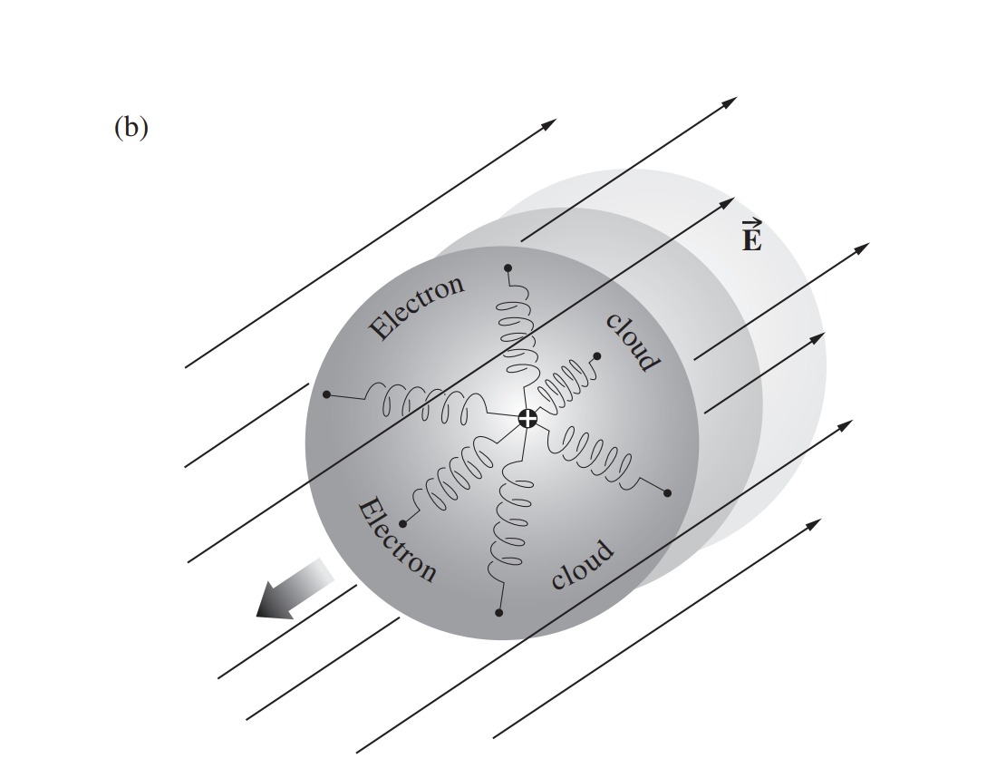
E-field of the Frequency Components
Lorentz model of the atom
The Lorentz model treats the atom as a harmonic oscillator
It provides a good description of the linear optical properties of atomic vapors
Nonlinearity of Lorentz model of the atom
Extending the restoring force
The details of the analysis differ depending upon “inversion symmetry of the medium”
Defect of Lorentz model
A single resonance frequency $ω_{0}$ to each atom : only one resonance frequency
In quantum-mechanical theory, it allows each atom to possess many energy eigenvalues and hence than one resonance frequency

Slide 38
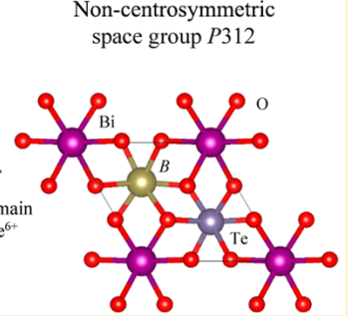

Noncentrosymmetric Media
F. Ding et al., Inorg. Chem. 57, 7950 (2018).
For noncentrosymmetric medium (electron position : $\tilde{x}$)
$$\ddot{\tilde{x}}+2γ\dot{\tilde{x}}+ω_{0}^{2}\tilde{x}+a{\tilde{x}}^{2}=−e\tilde{E}\left(t\right)/m$$
$\tilde{E}\left(t\right)$ : applied E-field, $−e$ : the charge of the electron and damping force : $−2mγ\dot{\tilde{x}}$
Restoring force : assuming that it is a nonlinear function of the displacement of the electron
$${\tilde{F}}_{restoring}=−mω_{0}^{2}\tilde{x}−ma{\tilde{x}}^{2}$$
$a$ : parameter about the strength of the nonlinearity
Potential energy
Anharmonic correction
$$U\left(\tilde{x}\right)=−\int{{\tilde{F}}_{restoring}d\tilde{x}=\frac{1}{2}mω_{0}^{2}{\tilde{x}}^{2}+\frac{1}{3}}ma{\tilde{x}}^{3}$$
Not perfectly parabolic
Even and odd powers of $\tilde{x}$
Scalar-field approximation : cannot treat the tensor of the nonlinear susceptibility without assumption about symmetry
https://opengeology.org/Mineralogy/10-crystal-morphology-and-symmetry/

Slide 39
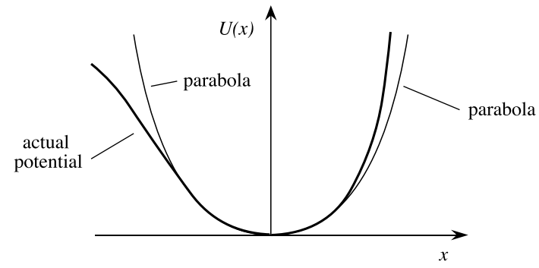
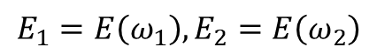
Perturbation Expansion Approach
Potential energy for a noncentrosymmetric medium
$$\ddot{\tilde{x}}+2γ\dot{\tilde{x}}+ω_{0}^{2}\tilde{x}+a{\tilde{x}}^{2}=−e\tilde{E}\left(t\right)/m$$
$$E_{1}=E\left(ω_{1}\right),E_{2}=E\left(ω_{2}\right)$$
Assuming the applied optical field
$$\tilde{E}\left(t\right)=E_{1}e^{−iω_{1}t}+E_{2}e^{−iω_{2}t}+c.c.$$
Assuming that the applied is sufficiently weak : $ω_{0}^{2}\tilde{x}≫a{\tilde{x}}^{2}$
Can be solved by means of a perturbation expansion
$$\tilde{E}\left(t\right)→λ\tilde{E}\left(t\right),0<λ≤1$$
Input $λ=1$ when finishing calculation
$$\ddot{\tilde{x}}+2γ\dot{\tilde{x}}+ω_{0}^{2}\tilde{x}+a{\tilde{x}}^{2}=−eλ\tilde{E}\left(t\right)/m$$
A solution is the form of a power-series expansion in the $λ$
$$\tilde{x}=λ{\tilde{x}}^{(1)}+λ^{2}{\tilde{x}}^{(2)}+λ^{3}{\tilde{x}}^{(3)}+…$$

Slide 40
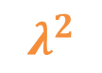
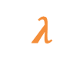
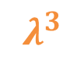
Perturbation Expansion Approach
$$\ddot{\tilde{x}}+2γ\dot{\tilde{x}}+ω_{0}^{2}\tilde{x}+a{\tilde{x}}^{2}=−eλ\tilde{E}\left(t\right)/m$$
$$\tilde{x}=λ{\tilde{x}}^{(1)}+λ^{2}{\tilde{x}}^{(2)}+λ^{3}{\tilde{x}}^{(3)}+…$$
$${\tilde{x}}^{2}=λ^{2}{\left[{\tilde{x}}^{\left(1\right)}\right]}^{2}+2λ^{3}{\tilde{x}}^{\left(1\right)}{\tilde{x}}^{(2)}+…$$
$$λ$$
$${\ddot{\tilde{x}}}^{(1)}+2γ{\dot{\tilde{x}}}^{(1)}+ω_{0}^{2}{\tilde{x}}^{(1)}=−e\tilde{E}\left(t\right)/m$$
(linear) Lorentz model
$$λ^{2}$$
$${\ddot{\tilde{x}}}^{(2)}+2γ{\dot{\tilde{x}}}^{(2)}+ω_{0}^{2}{\tilde{x}}^{(2)}+a{\left[{\tilde{x}}^{\left(1\right)}\right]}^{2}=0$$
$$λ^{3}$$
$${\ddot{\tilde{x}}}^{(3)}+2γ{\dot{\tilde{x}}}^{(3)}+ω_{0}^{2}{\tilde{x}}^{(3)}+2{\tilde{x}}^{\left(1\right)}{\tilde{x}}^{(2)}=0$$
Steady state solution in (linear) Lorentz model
$${\tilde{x}}^{\left(1\right)}\left(t\right)=x^{\left(1\right)}\left(ω_{1}\right)e^{−iω_{1}t}+x^{\left(1\right)}\left(ω_{2}\right)e^{−iω_{2}t}+c.c.$$
$$x^{\left(1\right)}\left(ω_{j}\right)=−\frac{e}{m}\frac{E_{j}}{D\left(ω_{j}\right)}$$
$$D\left(ω_{j}\right)=ω_{0}^{2}−ω_{j}^{2}−2iω_{j}γ$$

Slide 41
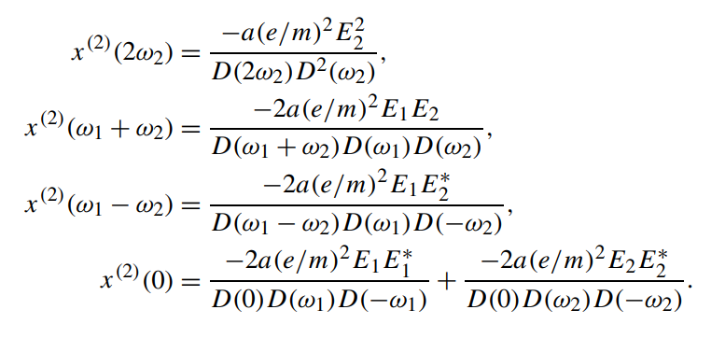
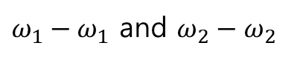
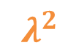
Perturbation Expansion Approach
$$λ^{2}$$
$${\ddot{\tilde{x}}}^{(2)}+2γ{\dot{\tilde{x}}}^{(2)}+ω_{0}^{2}{\tilde{x}}^{(2)}+a{\left[{\tilde{x}}^{\left(1\right)}\right]}^{2}=0$$
The square of ${\tilde{x}}^{\left(1\right)}$ contains several frequencies
$${\tilde{x}}^{\left(1\right)}\left(t\right)=x^{\left(1\right)}\left(ω_{1}\right)e^{−iω_{1}t}+x^{\left(1\right)}\left(ω_{2}\right)e^{−iω_{2}t}+c.c.$$
Another examples,
$$±2ω_{1},±2ω_{2},±\left(ω_{1}+ω_{2}\right),±\left(ω_{1}−ω_{2}\right) and 0$$
Choose the response at frequency $2ω_{1}$ for instance,
$${\ddot{\tilde{x}}}^{(2)}+2γ{\dot{\tilde{x}}}^{(2)}+ω_{0}^{2}{\tilde{x}}^{(2)}=−a{\left(\frac{eE_{1}}{m}\right)}^{2}\frac{e^{−2iω_{1}t}}{D^{2}\left(ω_{1}\right)}$$
Steady state solution
$ω_{1}−ω_{1}$ and $ω_{2}−ω_{2}$
$${\tilde{x}}^{\left(2\right)}\left(t\right)=x^{\left(2\right)}\left({2ω}_{1}\right)e^{−2iω_{1}t}$$
$$x^{\left(2\right)}\left({2ω}_{1}\right)=\left[−a{\left(\frac{eE_{1}}{m}\right)}^{2}\frac{1}{D^{2}\left(ω_{1}\right)}\right]\frac{1}{D\left(2ω_{1}\right)}=\frac{−a{\left(e/m\right)}^{2}E_{1}^{2}}{D\left(2ω_{1}\right)D^{2}\left(ω_{1}\right)}$$

Slide 42
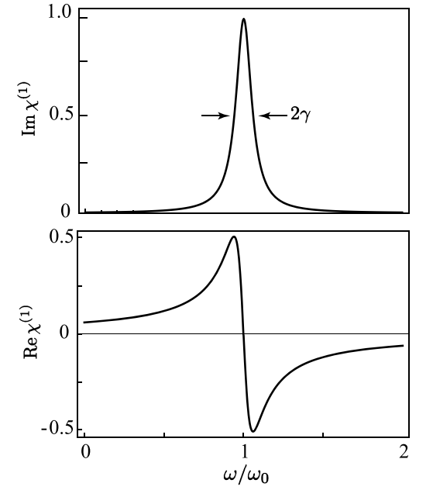
Linear Susceptibility
Linear susceptibility ($χ^{\left(1\right)}$)
Number density of atoms
$$P^{\left(1\right)}\left(ω_{j}\right)=ε_{0}χ^{\left(1\right)}\left(ω_{j}\right)E\left(ω_{j}\right)=−Nex^{\left(1\right)}\left(ω_{j}\right)$$
$$χ^{\left(1\right)}\left(ω_{j}\right)=−\frac{Ne}{ε_{0}}\frac{1}{E_{j}}x^{\left(1\right)}\left(ω_{j}\right)=\frac{Ne^{2}}{ε_{0}m}\frac{1}{D\left(ω_{j}\right)}$$
Close to resonance $ω_{j}≈ω_{0}$
$$D\left(ω_{j}\right)=ω_{0}^{2}−ω_{j}^{2}−2iω_{j}γ=\left(ω_{0}+ω_{j}\right)\left(ω_{0}−ω_{j}\right)−2iω_{j}γ≈2ω_{0}\left(ω_{j}−ω_{0}−iγ\right)$$
$$χ^{\left(1\right)}\left(ω_{j}\right)=\frac{Ne^{2}}{2ε_{0}mω_{0}}\frac{1}{\left(ω_{j}−ω_{0}−iγ\right)}=\frac{Ne^{2}}{2ε_{0}mω_{0}}\frac{\left(ω_{j}−ω_{0}\right)+iγ}{{\left(ω_{j}−ω_{0}\right)}^{2}+γ^{2}}$$
Atomic absorption
profile
FWHM
Resonance

Slide 43
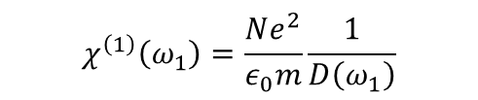
Nonlinear Susceptibility
Nonlinear susceptibility ($χ^{\left(2\right)}$)
Number density of atoms
$$P^{\left(2\right)}\left(2ω_{1}\right)=ε_{0}χ^{\left(2\right)}\left({2ω_{1};ω_{1},ω}_{1}\right)E{\left(ω_{1}\right)}^{2}=−Nex^{\left(2\right)}\left(2ω_{1}\right)$$
$$χ^{\left(2\right)}\left({2ω_{1};ω_{1},ω}_{1}\right)=−\frac{Ne}{ε_{0}}\frac{1}{E{\left(ω_{1}\right)}^{2}}x^{\left(2\right)}\left(2ω_{1}\right)=\frac{Ne^{3}a}{ε_{0}m^{2}}\frac{1}{D\left(2ω_{1}\right)D^{2}\left(ω_{1}\right)}$$
In terms of the product of linear susceptibilities
$$χ^{\left(1\right)}\left(ω_{1}\right)=\frac{Ne^{2}}{ε_{0}m}\frac{1}{D\left(ω_{1}\right)}$$
$$χ^{\left(2\right)}\left({2ω_{1};ω_{1},ω}_{1}\right)=\frac{ε_{0}ma}{Ne^{3}}χ^{\left(1\right)}\left(2ω_{1}\right){\left[χ^{\left(1\right)}\left(ω_{1}\right)\right]}^{2}$$
Second-order susceptibility as a function of three frequencies
For SFG case, one ($ω_{1}$) of the fields goes $ω_{2}$ and DFG case, Optical rectification ($ω_{1}$) case are
$$χ^{\left(2\right)}\left(ω_{1}+ω_{2};ω_{1},ω_{2}\right)=\frac{ε_{0}ma}{Ne^{3}}χ^{\left(1\right)}\left(ω_{1}+ω_{2}\right)χ^{\left(1\right)}\left(ω_{1}\right)χ^{\left(1\right)}\left(ω_{2}\right)$$
$$χ^{\left(2\right)}\left(ω_{1}−ω_{2};ω_{1},{−ω}_{2}\right)=\frac{ε_{0}ma}{Ne^{3}}χ^{\left(1\right)}\left(ω_{1}−ω_{2}\right)χ^{\left(1\right)}\left(ω_{1}\right)χ^{\left(1\right)}\left({−ω}_{2}\right)$$
$$χ^{\left(2\right)}\left(0;ω_{1},{−ω}_{1}\right)=\frac{ε_{0}ma}{Ne^{3}}χ^{\left(1\right)}\left(0\right)χ^{\left(1\right)}\left(ω_{1}\right)χ^{\left(1\right)}\left({−ω}_{1}\right)$$
If you want to know $χ^{\left(n\right)}$ susceptibility, you should expand $λ^{n}$

Slide 44

Miller’s Rule
Empirical rule due to Miller
$$\frac{χ^{\left(2\right)}\left({ω_{1}+ω_{2};ω_{1},ω}_{2}\right)}{χ^{\left(1\right)}\left(ω_{1}+ω_{2}\right)χ^{\left(1\right)}\left(ω_{1}\right)χ^{\left(1\right)}\left(ω_{2}\right)}$$
Nearly constant for all noncentrosymmetric crystals
Nearly constant
$$\frac{\frac{ε_{0}ma}{Ne^{3}}χ^{\left(1\right)}\left(ω_{1}+ω_{2}\right)χ^{\left(1\right)}\left(ω_{1}\right)χ^{\left(1\right)}\left(ω_{2}\right)}{χ^{\left(1\right)}\left(ω_{1}+ω_{2}\right)χ^{\left(1\right)}\left(ω_{1}\right)χ^{\left(1\right)}\left(ω_{2}\right)}=\frac{ε_{0}ma}{Ne^{3}}$$
Atomic number density $N$ : $\sim {10}^{22} cm^{−3}$ for all condensed matter and $m, e$ are constant
The size of the nonlinear coefficient $a$ by the linear and nonlinear contributions to the restoring force
Assuming that $\tilde{x} ≈$ size of the atom (separation between atoms; lattice constant $d$)
This reasoning leads to the order-of-magnitude estimate $mω_{0}^{2}d=mad^{2}$
$$a=ω_{0}^{2}/d$$
By reasons of nonsymmetry, $a≠0$
Roughly the same for all materials

Slide 45
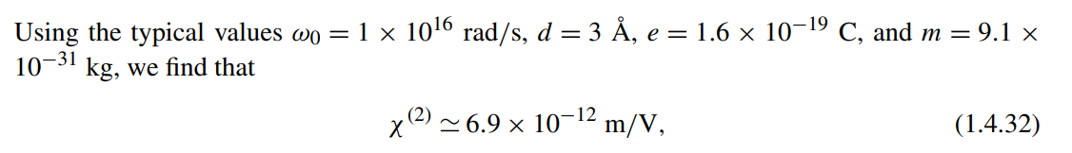
Nonlinear Coefficient
The estimate of nonlinear coefficient
$$D\left(ω_{j}\right)=ω_{0}^{2}−ω_{j}^{2}−2iω_{j}γ≈ω_{0}^{2}$$
To estimate of the size of the second-order susceptibility under highly nonresonant conditions
$$N=1/d^{3}$$
$$χ^{\left(2\right)}\left(ω_{1}+ω_{2};ω_{1},ω_{2}\right)=\frac{Ne^{3}a}{ε_{0}m^{2}}\frac{1}{D\left(ω_{1}+ω_{2}\right)D\left(ω_{1}\right)D\left(ω_{2}\right)}≈\frac{Ne^{3}a}{ε_{0}m^{2}ω_{0}^{6}}=\frac{e^{3}}{ε_{0}m^{2}ω_{0}^{4}d^{4}}$$

Slide 46
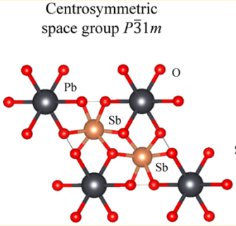
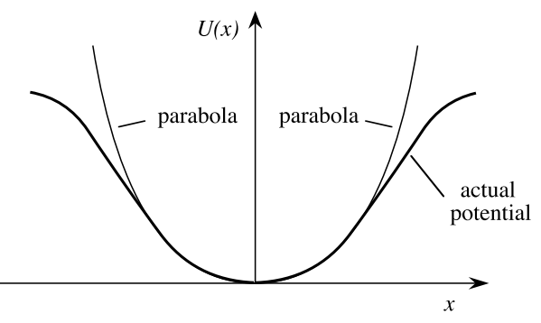
Centrosymmetric Media
F. Ding et al., Inorg. Chem. 57, 7950 (2018).
Electronic restoring force for centrosymmetric medium
lowest-order correction
$${\tilde{F}}_{restoring}=−mω_{0}^{2}\tilde{x}−mb{\tilde{x}}^{3}$$
$$U\left(\tilde{x}\right)=−\int{{\tilde{F}}_{restoring}d\tilde{x}=\frac{1}{2}mω_{0}^{2}{\tilde{x}}^{2}−\frac{1}{4}}mb{\tilde{x}}^{4}$$
$b$ : the strength of the nonlinearity (usually positive value)
Symmetry under the operation : $\tilde{x}→−\tilde{x}$
A center of inversion symmetry
Assuming that the electronic displacement $\tilde{x}$ never becomes so large
Nonlinear term contributes to third-order polarization as a $χ^{\left(3\right)}$ susceptibility
Cannot be specified unless the internal symmetries of the medium are completely known
Assuming that a material is isotropic
For examples, glasses and liquids
https://opengeology.org/Mineralogy/10-crystal-morphology-and-symmetry/

Slide 47
Equation of Motion for Isotropic Material
The equation of motion for the isotropic material
$${\tilde{F}}_{restoring}=−mω_{0}^{2}\tilde{r}−mb\left(\tilde{r}∙\tilde{r}\right)\tilde{r}$$
$$\ddot{\tilde{r}}+2γ\dot{\tilde{r}}+ω_{0}^{2}\tilde{r}−b\left(\tilde{r}∙\tilde{r}\right)\tilde{r}=−e\tilde{E}\left(t\right)/m$$
Assuming the input field has three distinct frequency components (for three-order interaction)
$$\tilde{E}\left(t\right)=\sum_{n}{E\left(ω_{n}\right)e^{−iω_{n}t}}$$
If anharmonics term is very weak, we can also use perturbation
$$\tilde{E}\left(t\right)→λ\tilde{E}\left(t\right),0<λ≤1$$
$$\tilde{r}=λ{\tilde{r}}^{(1)}+λ^{2}{\tilde{r}}^{(2)}+λ^{3}{\tilde{r}}^{(3)}+…$$
As in the previous case about $λ^{n}$,
$${\ddot{\tilde{r}}}^{(1)}+2γ{\dot{\tilde{r}}}^{(1)}+ω_{0}^{2}{\tilde{r}}^{(1)}=−e\tilde{E}\left(t\right)/m$$
$${\ddot{\tilde{r}}}^{(2)}+2γ{\dot{\tilde{r}}}^{(2)}+ω_{0}^{2}{\tilde{r}}^{(2)}=0$$
$${\ddot{\tilde{r}}}^{(3)}+2γ{\dot{\tilde{r}}}^{(3)}+ω_{0}^{2}{\tilde{r}}^{(3)}−b\left({\tilde{r}}^{\left(1\right)}∙{\tilde{r}}^{\left(1\right)}\right){\tilde{r}}^{\left(1\right)}=0$$

Slide 48
Linear Susceptibility
Steady-state solution
$${\tilde{r}}^{\left(1\right)}\left(t\right)=\sum_{n}{r^{(1)}\left(ω_{n}\right)e^{−iω_{n}t}}, r^{(1)}\left(ω_{n}\right)=−\frac{e}{m}\frac{E\left(ω_{n}\right)}{D\left(ω_{n}\right)}$$
The Cartesian components of the polarization
$$P^{\left(1\right)}\left(ω_{n}\right)=−Ner^{\left(1\right)}\left(ω_{n}\right)$$
$$P_{i}^{\left(1\right)}\left(ω_{n}\right)=ε_{0}\sum_{j}{χ_{ij}^{\left(1\right)}\left(ω_{n}\right)E_{j}\left(ω_{n}\right)}$$
Principal axes in linear susceptibility
$$χ_{ij}^{\left(1\right)}\left(ω_{n}\right)=χ^{\left(1\right)}\left(ω_{n}\right)δ_{ij}$$
$$χ^{\left(1\right)}\left(ω_{n}\right)=\frac{Ne^{2}}{m}\frac{1}{D\left(ω_{n}\right)}$$
The second-order response is not driven, ${\tilde{r}}^{\left(2\right)}=0$

Slide 49
Third-order Response
Third-order response
$${\ddot{\tilde{r}}}^{(3)}+2γ{\dot{\tilde{r}}}^{(3)}+ω_{0}^{2}{\tilde{r}}^{(3)}−b\left({\tilde{r}}^{\left(1\right)}∙{\tilde{r}}^{\left(1\right)}\right){\tilde{r}}^{\left(1\right)}=0$$
$$\left({\tilde{r}}^{\left(1\right)}∙{\tilde{r}}^{\left(1\right)}\right){\tilde{r}}^{\left(1\right)}=−\frac{e^{3}}{m^{3}}\frac{\left[E\left(ω_{m}\right)∙E\left(ω_{n}\right)\right]E\left(ω_{p}\right)}{D\left(ω_{m}\right)D\left(ω_{n}\right)D\left(ω_{p}\right)}e^{−i\left(ω_{m}+ω_{n}+ω_{p}\right)t}$$
Let these frequencies be $ω_{q}≡ω_{m}+ω_{n}+ω_{p}$
$${\tilde{r}}^{\left(3\right)}\left(t\right)=\sum_{q}{r^{(3)}\left(ω_{q}\right)e^{−iω_{q}t}}$$
$$\left(−ω_{q}^{2}−iw_{q}2γ+ω_{0}^{2}\right){\tilde{r}}^{\left(3\right)}\left(ω_{q}\right)=−\sum_{\left(mnp\right)}{\frac{be^{3}}{m^{3}}}\frac{\left[E\left(ω_{m}\right)∙E\left(ω_{n}\right)\right]E\left(ω_{p}\right)}{D\left(ω_{m}\right)D\left(ω_{n}\right)D\left(ω_{p}\right)}$$
$D\left(ω_{q}\right)=ω_{q}^{2}−iw_{q}2γ+ω_{0}^{2}$
$${\tilde{r}}^{\left(3\right)}\left(ω_{q}\right)=−\sum_{\left(mnp\right)}{\frac{be^{3}}{m^{3}}}\frac{\left[E\left(ω_{m}\right)∙E\left(ω_{n}\right)\right]E\left(ω_{p}\right)}{D\left(ω_{q}\right)D\left(ω_{m}\right)D\left(ω_{n}\right)D\left(ω_{p}\right)}$$

Slide 50
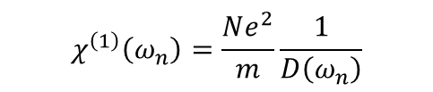
Third-order Response (cont.)
Third-order nonlinear susceptibility
$$P_{i}^{\left(3\right)}\left(ω_{q}\right)=−Ner^{\left(3\right)}\left(ω_{q}\right)$$
$$P_{i}^{\left(3\right)}\left(ω_{q}\right)=ε_{0}\sum_{jkl}{\sum_{\left(mnp\right)}{χ_{ijkl}^{\left(3\right)}\left(ω_{q};ω_{m},ω_{n},ω_{p}\right)E_{j}\left(ω_{m}\right)E_{k}\left(ω_{n}\right)E_{l}\left(ω_{p}\right)}}$$
Linear susceptibility has only principal axes
$$χ_{ijkl}^{\left(3\right)}\left(ω_{q};ω_{m},ω_{n},ω_{p}\right)=\frac{Nbe^{4}}{{ε_{0}m}^{3}}\frac{δ_{jk}δ_{il}}{D\left(ω_{q}\right)D\left(ω_{m}\right)D\left(ω_{n}\right)D\left(ω_{p}\right)}$$
$$χ^{\left(1\right)}\left(ω_{n}\right)=\frac{Ne^{2}}{m}\frac{1}{D\left(ω_{n}\right)}$$
Intrinsic permutation symmetry : Six possible permutations
So, we define one-six of the sum of the six expression
$$χ_{ijkl}^{\left(3\right)}\left(ω_{q};ω_{m},ω_{n},ω_{p}\right)=\frac{Nbe^{4}}{6ε_{0}m^{3}}\frac{2\left(δ_{ij}δ_{kl}+δ_{ik}δ_{jl}+δ_{jk}δ_{il}\right)}{D\left(ω_{q}\right)D\left(ω_{m}\right)D\left(ω_{n}\right)D\left(ω_{p}\right)}$$
$$χ_{ijkl}^{\left(3\right)}\left(ω_{q};ω_{m},ω_{n},ω_{p}\right)=\frac{bmε_{0}^{3}}{3N^{3}e^{4}}\left[χ^{\left(1\right)}\left(ω_{q}\right)χ^{\left(1\right)}\left(ω_{m}\right)χ^{\left(1\right)}\left(ω_{n}\right)χ^{\left(1\right)}\left(ω_{n}\right)\right]\left[δ_{ij}δ_{kl}+δ_{ik}δ_{jl}+δ_{jk}δ_{il}\right]$$

Slide 51

Estimate Nonlinear Coefficient
Estimate nonlinear coefficient $b$
The linear and nonlinear contributions to the restoring force will become comparable in magnitude
Atomic dimension $d$
$$b=ω_{0}^{2}/d^{2}$$
For nonresonant excitation, $D\left(ω\right)≈ω_{0}^{2}$
$$χ_{ijkl}^{\left(3\right)}\left(ω_{q};ω_{m},ω_{n},ω_{p}\right)=\frac{Nbe^{4}}{ε_{0}m^{3}}\frac{1}{D\left(ω_{q}\right)D\left(ω_{m}\right)D\left(ω_{n}\right)D\left(ω_{p}\right)}≈\frac{Nbe^{4}}{{ε_{0}m}^{3}ω_{0}^{8}}=\frac{e^{4}}{ε_{0}m^{3}ω_{0}^{6}d^{5}}$$

Slide 52
1.5 Properties of the Nonlinear Susceptibility

Slide 53




Estimate Nonlinear Coefficient
Symmetry properties
Considering the mutual interaction of three waves of frequencies $ω_{1},ω_{2},ω_{3}=ω_{1}+ω_{2}$
We should know nonlinear polarization $P\left(ω_{i}\right)$ for a complete description
$$P_{i}\left(ω_{n}+ω_{m}\right)=ε_{0}\sum_{jk}{\sum_{\left(n,m\right)}{χ_{ijk}^{\left(2\right)}\left(ω_{n}+ω_{m};ω_{n},ω_{m}\right)E_{j}\left(ω_{n}\right)E_{k}\left(ω_{m}\right)}}$$
Six tensor quantities of positive frequency
$$12$$
In Cartesian system, $i,j.k∈\left\{x,y,z\right\}$
$$3^{3}$$
So, If we don’t have any information about symmetry, we must know complex components of 324 to describe the interaction
Fortunately, there are a number of restrictions resulting from symmetry

Slide 54


Reality of the Fields
Real value of polarization & susceptibility
$${\tilde{P}}_{i}\left(r,t\right)=P_{i}\left(ω_{n}+ω_{m}\right)e^{−i\left(ω_{n}+ω_{m}\right)t}+P_{i}\left(−ω_{n}−ω_{m}\right)e^{i\left(ω_{n}+ω_{m}\right)t}$$
$$P_{i}\left(−ω_{n}−ω_{m}\right)=P_{i}{\left(ω_{n}+ω_{m}\right)}^{∗}$$
Purely real : physically measurable
$$E\left(−ω\right)=E{\left(ω\right)}^{∗}$$
$$χ_{ijk}^{\left(2\right)}\left(−ω_{n}−ω_{m};{−ω}_{n},−ω_{m}\right)=χ_{ijk}^{\left(2\right)}{\left(ω_{n}+ω_{m};ω_{n},ω_{m}\right)}^{∗}$$
We can directly obtain the negative frequency quantity from positive thing

Slide 55
Intrinsic Permutation Symmetric
Intrinsic permutation symmetric
For dummy indices,
$$P_{i}\left(ω_{n}+ω_{m}\right)=ε_{0}\sum_{jk}{\sum_{\left(n,m\right)}{χ_{ijk}^{\left(2\right)}\left(ω_{n}+ω_{m};ω_{n},ω_{m}\right)E_{j}\left(ω_{n}\right)E_{k}\left(ω_{m}\right)}}$$
$$j↔k,n↔m$$
$$P_{i}\left(ω_{n}+ω_{m}\right)=ε_{0}\sum_{jk}{\sum_{\left(n,m\right)}{χ_{ikj}^{\left(2\right)}\left(ω_{m}+ω_{n};ω_{m},ω_{n}\right)E_{k}\left(ω_{m}\right)E_{j}\left(ω_{n}\right)}}$$
Physically same quantities
So, $χ_{ijk}^{\left(2\right)}\left(ω_{n}+ω_{m};ω_{n},ω_{m}\right)$ must be equal to $χ_{ikj}^{\left(2\right)}\left(ω_{m}+ω_{n};ω_{m},ω_{n}\right)$
this condition is simply a statement that it cannot matter which is the first field and which is the second field in products
Note that this symmetry condition is introduced purely as a matter of convenience.

Slide 56

Symmetry for Lossless Media
Two additional symmetries of the nonlinear susceptibility tensor
Assuming that our frequencies are far from resonant frequency
Susceptibility goes real
$$χ^{\left(2\right)}\left(ω_{1}+ω_{2};ω_{1},ω_{2}\right)=\frac{Ne^{3}a}{ε_{0}m^{2}}\frac{1}{D\left(ω_{1}+ω_{2}\right)D\left(ω_{1}\right)D\left(ω_{2}\right)}≈\frac{Ne^{3}a}{ε_{0}m^{2}ω_{0}^{6}}$$
Fully permutation symmetry
All of the frequency arguments of the nonlinear susceptibility can be freely interchanged, as long as the corresponding Cartesian indices are interchanged simultaneously
$$ω_{3}=ω_{1}+ω_{2}$$
$$χ_{ijk}^{\left(2\right)}\left(ω_{3}=ω_{1}+ω_{2}\right)=χ_{jki}^{\left(2\right)}\left(ω_{1}=−ω_{2}+ω_{3}\right)$$
Example of two conditions
$$χ_{ijk}^{\left(2\right)}\left(ω_{3}=ω_{1}+ω_{2}\right)=χ_{jki}^{\left(2\right)}\left(−ω_{1}=ω_{2}−ω_{3}\right)=χ_{jki}^{\left(2\right)}{\left(ω_{1}=−ω_{2}+ω_{3}\right)}^{∗}=χ_{jki}^{\left(2\right)}\left(ω_{1}=−ω_{2}+ω_{3}\right)$$

Slide 57
Field Energy Density for a Linear Medium
Full permutation symmetry from EM-field energy
Full permutation symmetry of susceptibility is deduced from EM field energy within a nonlinear medium
Energy density according to Poynting’s theorem within a linear medium,
$${\tilde{E}}_{i}\left(t\right)=\sum_{n}{E_{i}\left(ω_{n}\right)e^{−iω_{n}t}}$$
$$U=\frac{1}{2}\left\langle \tilde{D}∙\tilde{E}\right\rangle =\frac{1}{2}\sum_{i}{\left\langle {\tilde{D}}_{i}{\tilde{E}}_{i}\right\rangle }$$
Displacement vector & dielectric tensor
$${\tilde{D}}_{i}\left(t\right)=ε_{0}\sum_{j}{ε_{ij}{\tilde{E}}_{j}\left(t\right)}=ε_{0}\sum_{j}{\sum_{n}{ε_{ij}\left(ω_{n}\right)E_{j}\left(ω_{n}\right)e^{−iω_{n}t}}}$$
$$ε_{ij}\left(ω_{n}\right)=δ_{ij}+χ_{ij}^{\left(1\right)}\left(ω_{n}\right)$$
Energy density
In vacuum
Polarization of the medium
$$U=\frac{1}{2}ε_{0}\sum_{i}{\sum_{n}{E_{i}^{∗}\left(ω_{n}\right)E_{i}\left(ω_{n}\right)}}+\frac{1}{2}ε_{0}\sum_{ij}{\sum_{n}{χ_{ij}^{\left(1\right)}\left(ω_{n}\right)E_{i}^{∗}\left(ω_{n}\right)E_{j}\left(ω_{n}\right)}}$$

Slide 58

Field Energy Density for a Nonlinear Medium
Full permutation symmetry from EM-field energy
Energy density according to Poynting’s theorem within a nonlinear medium,
General form is
$$U=\frac{ε_{0}}{2}\sum_{ij}{\sum_{n}{χ_{ij}^{\left(1\right)}\left(ω_{n}\right)E_{i}^{∗}\left(ω_{n}\right)E_{j}\left(ω_{n}\right)}}+\frac{ε_{0}}{3}\sum_{ijk}{\sum_{mn}{χ_{ijk}^{{\left(2\right)}^{′}}\left(−ω_{n}−ω_{m};ω_{m},ω_{n}\right)E_{i}^{∗}\left({ω_{m}+ω}_{n}\right)E_{j}\left(ω_{m}\right)E_{k}\left(ω_{n}\right)}}$$
$$+\frac{ε_{0}}{4}\sum_{ijkl}{\sum_{mno}{χ_{ijkl}^{{\left(3\right)}^{′}}\left(−ω_{o}−ω_{n}−ω_{m}; ω_{m},ω_{n},ω_{o}\right)E_{i}^{∗}\left({ω_{m}+ω}_{n}+ω_{o}\right)E_{j}\left(ω_{m}\right)E_{k}\left(ω_{n}\right)E_{l}\left(ω_{o}\right)+…}}$$
$χ^{{\left(n\right)}^{′}}$ as coefficients in the power series expansion of $U$
The order of Multiplied E-fields is not immaterial, so, the quantity $χ^{{\left(n\right)}^{′}}$is full permutation symmetry
The polarization of a medium is given by the expression
$$P_{i}\left(ω_{n}\right)=\frac{∂U}{∂E_{i}^{∗}\left(ω_{n}\right)}$$

Slide 59



Field Energy Density for a Nonlinear Medium
$$P_{i}\left(ω_{n}\right)=\frac{∂U}{∂E_{i}^{∗}\left(ω_{n}\right)}$$
Linear and nonlinear polarization
$$U=\frac{ε_{0}}{2}\sum_{ij}{\sum_{n}{χ_{ij}^{\left(1\right)}\left(ω_{n}\right)E_{i}^{∗}\left(ω_{n}\right)E_{j}\left(ω_{n}\right)}}+\frac{ε_{0}}{3}\sum_{ijk}{\sum_{mn}{χ_{ijk}^{{\left(2\right)}^{′}}\left(−ω_{n}−ω_{m};ω_{m},ω_{n}\right)E_{i}^{∗}\left({ω_{m}+ω}_{n}\right)E_{j}\left(ω_{m}\right)E_{k}\left(ω_{n}\right)}}$$
$$+\frac{ε_{0}}{4}\sum_{ijkl}{\sum_{mno}{χ_{ijkl}^{{\left(3\right)}^{′}}\left(−ω_{o}−ω_{n}−ω_{m}; ω_{m},ω_{n},ω_{o}\right)E_{i}^{∗}\left({ω_{m}+ω}_{n}+ω_{o}\right)E_{j}\left(ω_{m}\right)E_{k}\left(ω_{n}\right)E_{l}\left(ω_{o}\right)+…}}$$
Linear polarization
$$P_{i}^{\left(1\right)}\left(ω_{m}\right)=\frac{∂U}{∂E_{i}^{∗}\left(ω_{m}\right)}=ε_{0}\sum_{j}{χ_{ij}^{\left(1\right)}\left(ω_{m}\right)E_{j}\left(ω_{m}\right)}$$
Nonlinear polarization
$$P_{i}^{\left(2\right)}\left(ω_{m}+ω_{n}\right)=ε_{0}\sum_{jk}{\sum_{mn}{χ_{ijk}^{{\left(2\right)}^{′}}\left(−ω_{n}−ω_{m};ω_{m},ω_{n}\right)E_{j}\left(ω_{m}\right)E_{k}\left(ω_{n}\right)}}$$
$$P_{i}^{\left(3\right)}\left(ω_{m}+ω_{n}+ω_{o}\right)=ε_{0}\sum_{jkl}{\sum_{mno}{χ_{ijk}^{{\left(3\right)}^{′}}\left(−ω_{m}−ω_{n}−ω_{o};ω_{m},ω_{n},ω_{o}\right)E_{j}\left(ω_{m}\right)E_{k}\left(ω_{n}\right)}}E_{l}\left(ω_{o}\right)$$
Sign of first frequency
$χ^{{\left(n\right)}^{′}}$ possesses full permutation symmetry, so $χ^{\left(n\right)}$ does.

Slide 60




Supple : calculate the polarization
$$\frac{∂E_{i}^{∗}\left(ω_{m}\right)}{∂E_{i}^{∗}\left(ω_{m}\right)},\frac{∂E_{j}^{∗}\left(ω_{m}\right)}{∂E_{i}^{∗}\left(ω_{m}\right)}$$
Linear polarization
$$P_{i}^{\left(1\right)}\left(ω_{m}\right)=\frac{∂U}{∂E_{i}^{∗}\left(ω_{m}\right)}=\frac{∂}{∂E_{i}^{∗}\left(ω_{m}\right)}\frac{ε_{0}}{2}\sum_{ij}{χ_{ij}^{\left(1\right)}\left(ω_{m}\right)E_{i}^{∗}\left(ω_{m}\right)E_{j}\left(ω_{m}\right)}=$$
$$\frac{ε_{0}}{2}\sum_{ij}{χ_{ij}^{\left(1\right)}\left(ω_{m}\right)E_{j}\left(ω_{m}\right)δ_{ii}}+\frac{ε_{0}}{2}\sum_{ji}{χ_{ji}^{\left(1\right)}\left(ω_{m}\right)E_{i}\left(ω_{m}\right)δ_{ij}}=ε_{0}\sum_{j}{χ_{ij}^{\left(1\right)}\left(ω_{m}\right)E_{j}\left(ω_{m}\right)}$$
$$\frac{∂E_{i}^{∗}\left({ω_{m}+ω}_{n}\right)}{∂E_{i}^{∗}\left({ω_{m}+ω}_{n}\right)},\frac{∂E_{j}^{∗}\left(ω_{m}\right)}{∂E_{i}^{∗}\left({ω_{m}+ω}_{n}\right)},\frac{∂E_{k}^{∗}\left(ω_{n}\right)}{∂E_{i}^{∗}\left({ω_{m}+ω}_{n}\right)}$$
Nonlinear polarization
$$P_{i}^{\left(2\right)}\left(ω_{m}+ω_{n}\right)=\frac{∂U}{∂E_{i}^{∗}\left(ω_{m}+ω_{n}\right)}=\frac{∂}{∂E_{i}^{∗}\left(ω_{m}+ω_{n}\right)}\frac{ε_{0}}{3}\sum_{ijk}{\sum_{mn}{χ_{ijk}^{{\left(2\right)}^{′}}\left(−ω_{n}−ω_{m};ω_{m},ω_{n}\right)E_{i}^{∗}\left({ω_{m}+ω}_{n}\right)E_{j}\left(ω_{m}\right)E_{k}\left(ω_{n}\right)}}$$
$$=\frac{ε_{0}}{3}\sum_{ijk}{\sum_{mn}{χ_{ijk}^{{\left(2\right)}^{′}}δ_{ii}E_{j}\left(ω_{m}\right)E_{k}\left(ω_{n}\right)}}$$
$$+\frac{ε_{0}}{3}\sum_{ijk}{\sum_{mn}{χ_{ijk}^{{\left(2\right)}^{′}}δ_{ij}δ_{m,m+n}E_{i}\left({ω_{m}+ω}_{n}\right)E_{k}\left(ω_{n}\right)}}$$
$$+\frac{ε_{0}}{3}\sum_{ijk}{\sum_{mn}{χ_{ijk}^{{\left(2\right)}^{′}}δ_{ik}δ_{n,m+n}E_{i}\left({ω_{m}+ω}_{n}\right)E_{j}\left(ω_{m}\right)}}$$

Slide 61


Kleinman’s Symmetry
Nonresonant case under the low-frequency excitation
Quite often, in nonlinear optical interactions
Optical waves ($ω_{i}$) are much smaller than the lowest resonance frequency of material system
Susceptibility is essentially independent of frequency
$$χ^{\left(2\right)}\left(ω_{1}+ω_{2};ω_{1},ω_{2}\right)≈\frac{e^{3}}{ε_{0}m^{2}ω_{0}^{4}d^{4}}$$
The system responds instantaneously to the applied field
$$\tilde{P}\left(t\right)=ε_{0}χ^{\left(2\right)}{\tilde{E}}^{2}\left(t\right)$$
Full permutation symmetry is valid under our circumstances
But, susceptibility doesn’t depend on the frequencies
Kleinman symmetry condition : no dispersion of the susceptibility

Slide 62


Contracted Notation
Introducing notation when the Kleinman symmetry condition is valid
The tensor
Just convention
$$d_{ijk}=\frac{1}{2}χ_{ijk}^{\left(2\right)}$$
Nonlinear polarization
$$P_{i}\left(ω_{n}+ω_{m}\right)=ε_{0}\sum_{jk}{\sum_{\left(nm\right)}{2d_{ijk}E_{j}\left(ω_{n}\right)E_{k}\left(ω_{m}\right)}}$$
Assuming that $d_{ijk}$ is symmetric in its last two indices
Valid whenever Kleinman’s symmetry condition is valid
Generally, it is valid for SHG
Nonlinear susceptibility tensor : $(3×6)$ matrix

Slide 63


Contracted Notation
Introducing notation when the Kleinman symmetry condition is valid
Not all of the 18 elements are independent under the Kleinman symmetry condition
$$d_{12}≡d_{122}=d_{212}≡d_{26}, d_{14}≡d_{123}=d_{213}≡d_{25}$$
Only 10 independent elements
The nonlinear polarization leading to SHG

Slide 64


Contracted Notation
Introducing notation when the Kleinman symmetry condition is valid
The nonlinear polarization leading to SFG $(ω_{3}=ω_{1}+ω_{2})$

Slide 65




Effective Value
Midwinter, J.E., Warner, J., 1965. Br. J. Appl. Phys. 16, 1135.
Nonlinear polarization for a fixed geometry (propagation direction and polarization)
It is possible to express the nonlinear polarization (SFG and SHG)
$$P\left(ω_{3}\right)=4ε_{0}d_{eff}E\left(ω_{1}\right)E\left(ω_{2}\right)$$
$$P\left(ω\right)=\left|P\left(ω\right)\right|$$
$$E\left(ω\right)=\left|E\left(ω\right)\right|$$
$$P\left(2ω\right)=2ε_{0}d_{eff}E{\left(ω\right)}^{2}$$
$d_{eff}$ is obtained by determining $P\left(ω\right)$ in matrix equation and then calculating its norm $P\left(ω\right)=\left|P\left(ω\right)\right|$
For example, negative uniaxial of crystal class 3m (as type II condition)

Slide 66



Effective Value
Midwinter, J.E., Warner, J., 1965. Br. J. Appl. Phys. 16, 1135.
Nonlinear polarization for a fixed geometry (propagation direction and polarization)
For example, negative uniaxial of crystal class 3m (as type II condition)
$d_{eff}=d_{22}\cos^{2}{θ}\cos{3φ}$
$θ$ : the angle between the propagation vector and the crystalline $z$ axis (the optic axis)
$φ$ : the azimuthal angle between the crystalline $x$ axis and the projection for the propagation vector onto the $xz$ crystalline plane

Slide 67
Spatial Symmetry of Nonlinear Medium
Fourfold axis of symmetry
The linear and nonlinear susceptibility tensors are constrained by the symmetry properties of the optical medium.
$\text{C}\text{onsider} \text{a} \text{crystal} \text{for} \text{which} \text{the} \text{x} \text{and} \text{y} \text{directions} \text{are} \text{equivalent} \text{but} \text{for} \text{which} \text{the} \text{z} \text{direction} \text{is} \text{different}$
$$χ_{zxx}^{\left(2\right)}=χ_{zyy}^{\left(2\right)}$$
If the crystal were rotated by 90 degrees about the z axis, crystal structure would look identical.
Nonlinear polarization for a fixed geometry (propagation direction and polarization)
The linear and nonlinear optical susceptibilities
determined by symmetry properties
What types of symmetry properties can occur in a crystalline medium
mathematical method (group theory)

Slide 68


Spatial Symmetry of Nonlinear Medium
Crystal Classification by group theory
32 possible crystal classes depending on the point group symmetry of the crystal
Fourfold axis of symmetry : point group 4
Three-fold axis of symmetry and a plane of mirror symmetry parallel to this axis : point group 3m
R. Ballou, Crystallography: Symmetry groups and group representations, Eur. Phys. J. Conf. 22, 00006 (2012).
https://opengeology.org/Mineralogy/10-crystal-morphology-and-symmetry/

Slide 69



Influence of Spatial Symmetry
Considering symmetry imposes on the linear susceptibility tensor
Five difference cases by a group theorical analysis
Isotropic materials are also included in below table
Biaxial crystals
Isotropic crystal : only diagonal with equal diagonal components
Anisotropic crystal : polarization needs not to parallel to E-field (Birefringence)
Tetragonal, Trigonal, Hexagonal crystal : uniaxial crystals
$$\frac{x^{2}+y^{2}}{n_{o}^{2}}+\frac{z^{2}}{n_{e}^{2}}=1$$
Rotational symmetry

Slide 70

Influence of Spatial Symmetry
Crystals are categorized seven possible crystal systems
32 point group

Slide 71

Influence of Spatial Symmetry (Nonlinear Response)
Centrosymmetry (inversion symmetry)
$χ^{\left(2\right)}$ must vanish
11 of the 32 crystal classes : inversion symmetry
Proof why inversion symmetry vanish second-order susceptibility
Assuming medium that responds instantaneously to the applied optical field
$$\tilde{P}\left(t\right)=ε_{0}χ^{\left(2\right)}{\tilde{E}}^{2}\left(t\right)$$
$$\tilde{E}\left(t\right)=ℰ\cos{ωt}$$
Must be same : $χ^{\left(2\right)}=0$
$\tilde{E}\left(t\right)→−\tilde{E}\left(t\right),$ then $\tilde{P}\left(t\right)→−\tilde{P}\left(t\right)$ by inversion symmetry
$$−\tilde{P}\left(t\right)=ε_{0}χ^{\left(2\right)}{\left[−\tilde{E}\left(t\right)\right]}^{2}$$

Slide 72

Influence of Spatial Symmetry (Nonlinear Response)
Intuitively by considering the motion of an electron in a nonparabolic potential well
$(b)$ : no distortion
$(c)$ : odd harmonics; time-averaged response is zero
$(d)$ : even and odd harmonics; time-averaged response is not zero

Slide 73



Influence of Spatial Symmetry (Nonlinear Susceptibility)
For example, here’s a crystal of class 3m
Kleinman symmetry is also involved
$d_{il}$ matrix
Caution : considerable spread in the values of the nonlinear coefficients
Because of the wavelength dependence of the nonlinear and measurement inaccuracies

Slide 74







Number of Independent Elements of Susceptibility
How to reduce the elements
$\left(1\right)$ for describing mutual interaction of three optical waves
$$324$$
$\left(2\right)$ Physical fields (polarization, E-field) are real
$$162$$
$\left(3\right)$ Intrinsic permutation symmetry (about input fields)
$$81$$
$\left(4\right)$ lossless medium (real susceptibility) and full permutation symmetry
$$ω_{3}=ω_{1}+ω_{2}$$
$$27$$
Frequency indices + E-field indices : simultaneously
$\left(4\right)$ For SHG
$$18$$
$\left(4\right)$ Kleinman’s symmetry (low-frequency excitation)
Considering input fields
$$10$$

Slide 75


Noncentrosymmetric and Cubic Crystal Classes
A material can possess a culbic lattice and be noncentrosymmetric
Gallium arsenide : structure as the zincblende
Its point group : $\overline{4}3m$ : nonvanishing second-order nonlinear optical response
Cubic lattice : Gallium arsenide doesn’t display birefringence
Hard phase-matching
Birefringence is commonly used to achieve phase-matching
But cubic lattice is isotropic, it is too hard to achieve it
noncentrosymmetric
cubic lattice (isotropic)
Not zero

Slide 76

Noncentrosymmetric and Cubic Crystal Classes
Different nearest-neighbors give different characteristic
Diamond structure : cubic lattice and centrosymmetric $χ^{\left(2\right)}=0$
Zincblende structure : cubic lattice and noncentrosymmetric $χ^{\left(2\right)}≠0$

Slide 77


Noncentrosymmetric and Polar Crystal Classes
Restrict condition that possess a nonzero second-order susceptibility
Certain crystal possess a permanent dipole moment
Polar crystals, ferroelectric crystals
They can display the pyroelectric effect and photorefractive effect
A change of permanent dipole moment with temperature
which can be used to construct optical detector
Ferroelectric crystals within group theoretical arguments
Always Yes!
Polar crystals
Noncentrosymmetric crystal
Always No!
For example, ${CCl}_{4}$ cannot posses a permanent dipole moment. But it is noncentrosymmetric

Slide 78

Third Order Nonlinear Response
Pass

Slide 79
Time-Domain Description of Optical Linearities
Describing optical nonlinearities directly in the time domain
Sometimes more convenient than frequency domain (Short pulse applied field)
Frequency domain is useful when input field is nearly monochromatic
A purely linear response
$${\tilde{P}}^{\left(1\right)}\left(t\right)=ε_{0}\int_{0}^{∞}{R^{\left(1\right)}\left(τ\right)\tilde{E}\left(t−τ\right)dτ}$$
$R^{\left(1\right)}\left(τ\right)$ : linear response function
Contribution to the polarization produced at time $t$ by an E-field applied at earlier time $t−τ$
Low limit of integration is 0 by causality : ${\tilde{P}}^{\left(1\right)}\left(t\right)$ depends only on past
Transformed to the frequency domain (FT)
$$E\left(ω\right)=\int_{−∞}^{∞}{\tilde{E}\left(t\right)e^{iωt}dt}$$
$$\tilde{E}\left(t\right)=\frac{1}{2π}\int_{−∞}^{∞}{E\left(ω\right)e^{−iωt}dω}$$

Slide 80

Time-Domain Description of Optical Linearities
FT of the polarization & linear susceptibility
$${\tilde{P}}^{\left(1\right)}\left(t\right)=\frac{ε_{0}}{2π}\int_{0}^{∞}{dτ}\int_{−∞}^{∞}{R^{\left(1\right)}\left(τ\right)E\left(ω\right)e^{−iω\left(t−τ\right)}dω}=\frac{ε_{0}}{2π}\int_{−∞}^{∞}{dω}\left[\int_{−0}^{∞}{dτR^{\left(1\right)}\left(τ\right)e^{iωτ}}\right]E\left(ω\right)e^{−iωt}$$
$${\tilde{P}}^{\left(1\right)}\left(t\right)=\frac{ε_{0}}{2π}\int_{−∞}^{∞}{dω}χ^{\left(1\right)}\left(ω;ω\right)E\left(ω\right)e^{−iωt}$$
Polarization of linear response
$${\tilde{P}}^{\left(1\right)}\left(t\right)=\frac{1}{2π}\int_{−∞}^{∞}{dω}\left[ε_{0}χ^{\left(1\right)}\left(ω;ω\right)E\left(ω\right)\right]e^{−iωt}=\frac{1}{2π}\int_{−∞}^{∞}{dω}P\left(ω\right)e^{−iωt}$$

Slide 81



Time-Domain Description of Optical Nonlinearities
FT of Second-order response function
$${\tilde{P}}^{\left(2\right)}\left(t\right)=ε_{0}\int_{0}^{∞}{dτ_{1}\int_{0}^{∞}{dτ_{2}R^{\left(2\right)}\left(τ_{1},τ_{2}\right)\tilde{E}\left(t−τ_{1}\right)\tilde{E}\left(t−τ_{2}\right)}}$$
$R^{\left(2\right)}\left(τ_{1}−τ_{2}\right)=0$ if either $τ_{1}$ or $τ_{1}$ is negative
$$ω_{σ}=ω_{1}+ω_{2}$$
$${\tilde{P}}^{\left(2\right)}\left(t\right)=\int_{−∞}^{∞}{\frac{dω_{1}}{2π}}\int_{−∞}^{∞}{\frac{dω_{2}}{2π}}ε_{0}\int_{0}^{∞}{dτ_{1}\int_{0}^{∞}{dτ_{2}R^{\left(2\right)}\left(τ_{1},τ_{2}\right)E\left(ω_{1}\right)e^{−iω_{1}\left(t−τ_{1}\right)}E\left(ω_{2}\right)e^{−iω_{2}\left(t−τ_{2}\right)}}}$$
$$=ε_{0}\int_{−∞}^{∞}{\frac{dω_{1}}{2π}}\int_{−∞}^{∞}{\frac{dω_{2}}{2π}}\left[\int_{0}^{∞}{dτ_{1}\int_{0}^{∞}{dτ_{2}R^{\left(2\right)}\left(τ_{1},τ_{2}\right)e^{−iω_{1}τ_{1}}e^{−iω_{2}τ_{2}}}}\right]E\left(ω_{1}\right)E\left(ω_{2}\right)e^{−iω_{σ}t}$$
$$=ε_{0}\int_{−∞}^{∞}{\frac{dω_{1}}{2π}}\int_{−∞}^{∞}{\frac{dω_{2}}{2π}}χ^{\left(2\right)}\left(ω_{σ};ω_{1},ω_{2}\right)E\left(ω_{1}\right)E\left(ω_{2}\right)e^{−iω_{σ}t}$$
Third-order

Slide 82

Kramers-Kronig Relation
Kramers-Kronig (KK) relations
These condition relate real and imaginary parts of frequency-dependent quantities
A knowledge of the frequency dependence of the imaginary part → the real part of the susceptibility at some frequency
Measuring an absorption spectrum : easier than to measure the frequency dependence of the refractive index

Slide 83

Kramers-Kronig Relation in Linear Optics
Kramers-Kronig (KK) relations in linear optics
$$χ^{\left(1\right)}\left(ω\right)≡χ^{\left(1\right)}\left(ω;ω\right)=\int_{−0}^{∞}{dτR^{\left(1\right)}\left(τ\right)e^{iωτ}}$$
$R^{\left(1\right)}\left(τ\right) ∈ℝ$ : polarization and applied field is real quantities
$$χ^{\left(1\right)}\left(−ω\right)=χ^{\left(1\right)}{\left(ω\right)}^{∗}$$
$χ\left(ω\right)$ is analytic (single valued and possessing continuous derivatives)
$$ω=Re ω+Im ω$$
$χ\left(ω\right)$ in the upper half of the complex $ω$ plane : $Im ω ≥0$
$$\int_{−0}^{∞}{dτR^{\left(1\right)}\left(τ\right)e^{i\left[Re ω+Im ω\right]τ}}$$
$Im ω >0$ for convergence
$Im ω=0$ : $R^{\left(1\right)}\left(τ\right)$ must be square integrable; $ω$ is physically measurable quantity

Slide 84








Kramers-Kronig Relation in Linear Optics
Cauchy principal value of the integral
Residue theory
Considering the integral with simple pole
$$Int=\int_{−∞}^{∞}{\frac{χ^{\left(1\right)}\left(ω^{′}\right){dω}^{′}}{ω^{′}−ω}}$$
Cauchy principal value of the integral
$$\int_{−∞}^{∞}{\frac{χ^{\left(1\right)}\left(ω^{′}\right)ω^{′}}{ω^{′}−ω}}≡\lim_{δ→0}\left[\int_{−∞}^{ω−δ}{\frac{χ^{\left(1\right)}\left(ω^{′}\right){dω}^{′}}{ω^{′}−ω}}+\int_{δ+ω}^{∞}{\frac{χ^{\left(1\right)}\left(ω^{′}\right)dω^{′}}{ω^{′}−ω}}\right]$$
$Int a=0$ : closed path
Desired integral
$$Int=Int a−Int b−Int c$$
$Int b=0$ : $\left|ω′\right|→∞$
Integrand $χ^{\left(1\right)}\left(ω^{′}\right)/\left|ω′\right|→0$
Finite response time
$$Int c=−\frac{i}{π}χ^{\left(1\right)}\left(ω\right), χ^{\left(1\right)}\left(ω\right)=\int_{−∞}^{∞}{\frac{χ^{\left(1\right)}\left(ω^{′}\right){dω}^{′}}{ω^{′}−ω}}$$

Slide 85
Kramers-Kronig Relation in Linear Optics
Cauchy principal value of the integral
$χ^{\left(1\right)}\left(ω\right)=Re χ^{\left(1\right)}\left(ω\right)+iIm χ^{\left(1\right)}\left(ω\right)$
$$χ^{\left(1\right)}\left(ω\right)=−\frac{i}{π}\int_{−∞}^{∞}{\frac{\left[Re χ^{\left(1\right)}\left(ω^{′}\right)+iIm χ^{\left(1\right)}\left(ω^{′}\right)\right]{dω}^{′}}{ω^{′}−ω}}$$
$$Re χ^{\left(1\right)}\left(ω\right)=\frac{1}{π}\int_{−∞}^{∞}{\frac{\left[Im χ^{\left(1\right)}\left(ω^{′}\right)\right]{dω}^{′}}{ω^{′}−ω}}, Im χ^{\left(1\right)}\left(ω\right)=\frac{−1}{π}\int_{−∞}^{∞}{\frac{\left[Re χ^{\left(1\right)}\left(ω^{′}\right)\right]{dω}^{′}}{ω^{′}−ω}}$$
It is usually easier to measure absorption spectra than the frequency dependence of the refractive index

